Slide 1
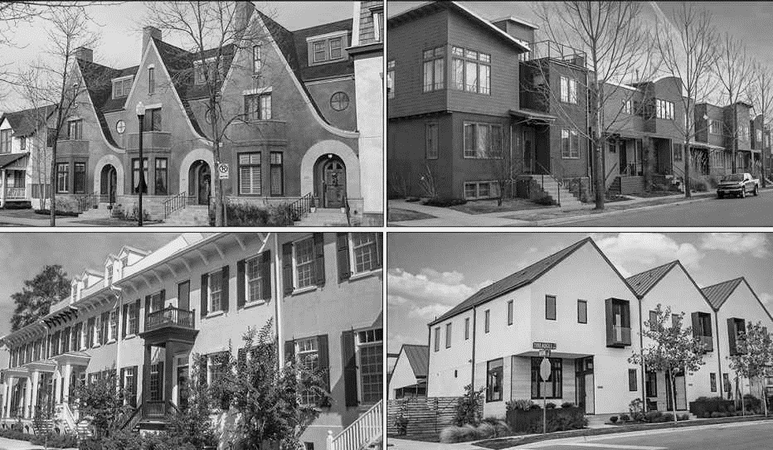
Middle Housing
Survey Results
House Bill 1110 |RCW 36.70A.635

Slide 2
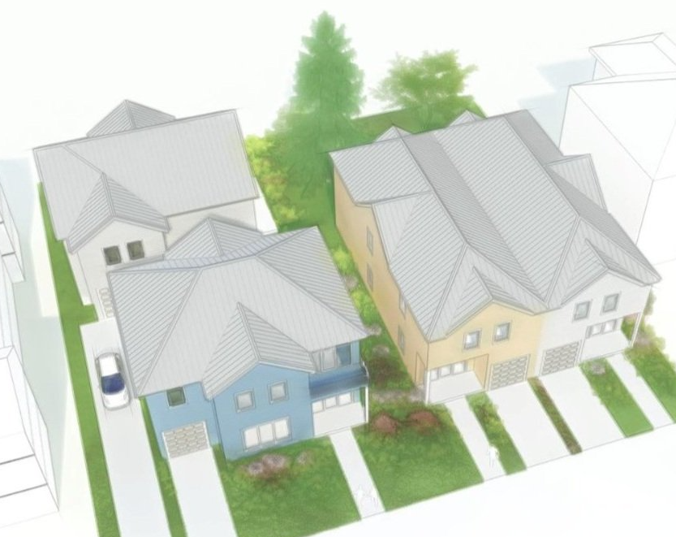
Middle Housing Definition and Types
Middle Housing means buildings that are compatible in scale, form, and character with single-family houses and contain two or more attached, stacked, or clustered homes including duplex, triplex, fourplex, five-plex, six-plex, townhouses, stacked flats, courtyard apartments and cottage housing.
Lacey must allow a minimum of six of the
nine middle housing types.

Slide 3
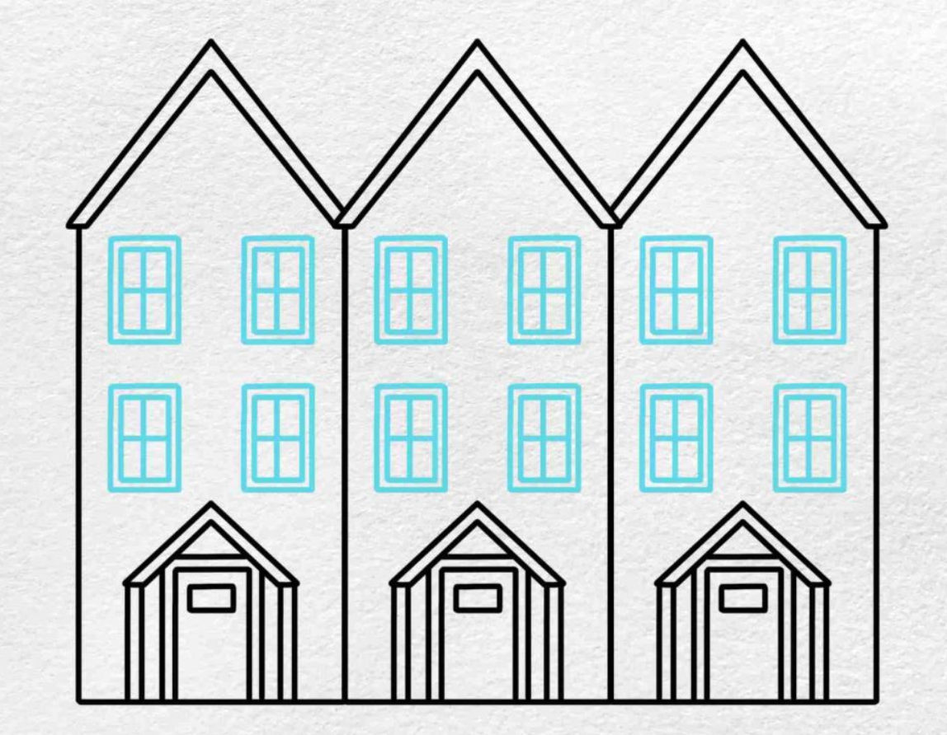
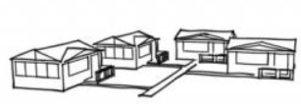
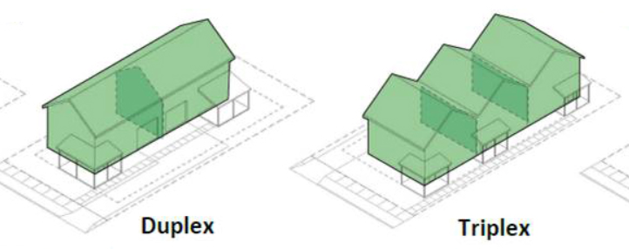
What Lacey Already Allows
Low-Density Residential District
LMC Title 16 Zoning
Chapter 16.13
Permitted Middle Housing Types
Cottage housing
Townhouses
Duplexes
Triplexes
Cottage Housing
Townhouses
Notes:
The purpose of the survey was to get feedback for the types of housing that the community prioritizes or feels most strongly about. While this is a requirement feedback is helpful to moving forward.

Slide 4
November through December | 2024
Distribution Methods
Middle Housing Webpage
Facebook/Instagram Posts
Lacey Life
Targeted Survey Mailer

Slide 5
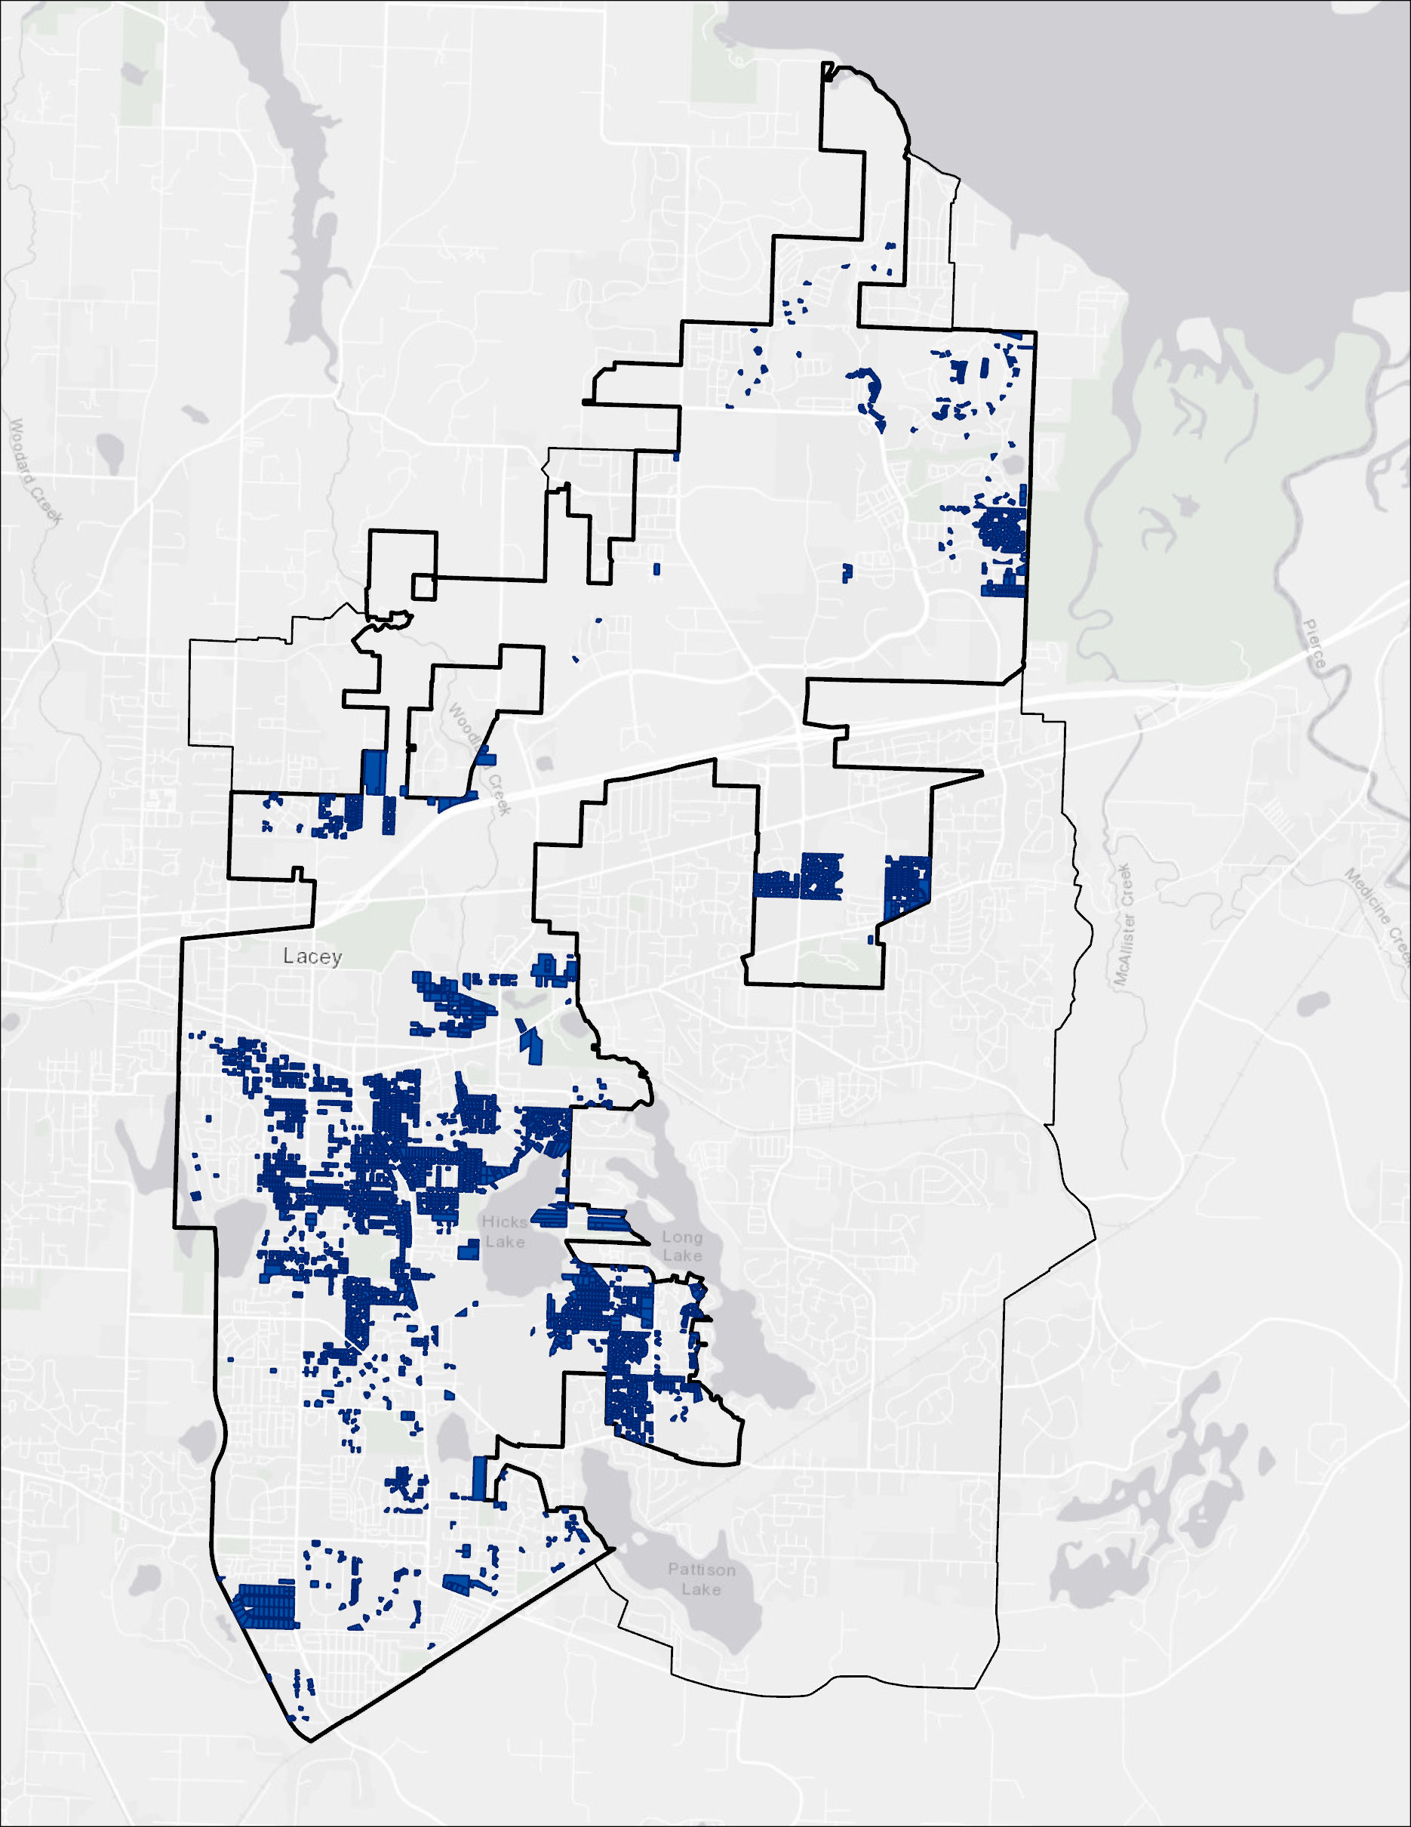
City of Lacey
Targeted Survey Mailer
3,000 + parcels
LD, MD
City Limits
10,000 sq ft +
200’ to active sewer

Slide 6
Total Survey Responses
Q1: Do you live in the
City of Lacey?
361
Yes = 333
No = 28

Slide 7
Who did we primarily hear from?
Females
Caucasian/White
35 – 65 +
54%
Annual Household Income
$75,000 +
62%
59%
82%

Slide 8
Rating System |Housing Types
Strongly Disapprove
Disapprove
Neutral
Approve
Strongly Approve

Slide 9
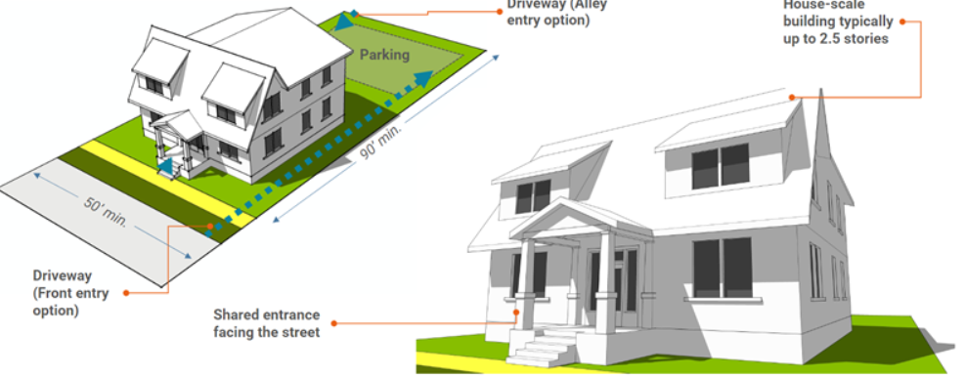
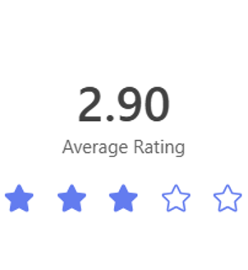
Fourplex
Residential building with four attached dwelling units.

Slide 10
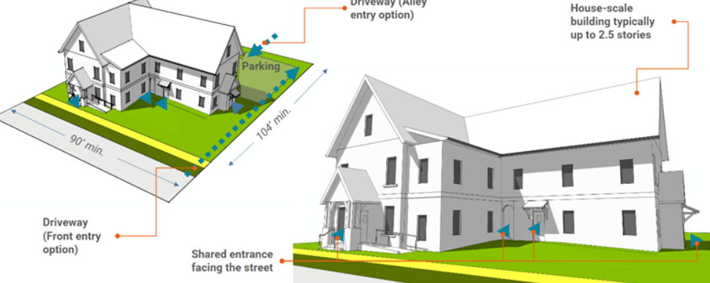
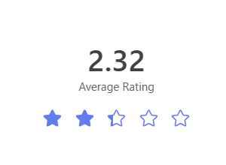
Five-plex
Residential building with five attached dwelling units.

Slide 11
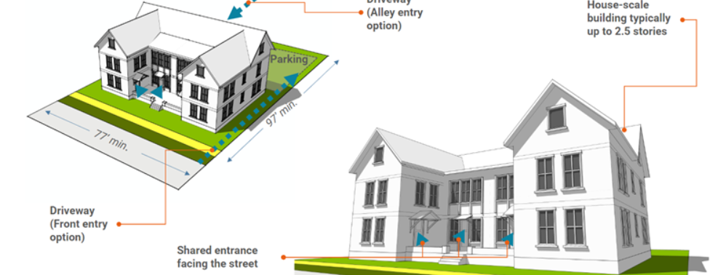
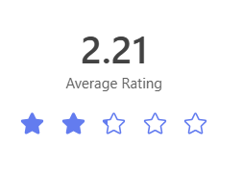
Six-plex
Residential building with six attached dwelling units.

Slide 12
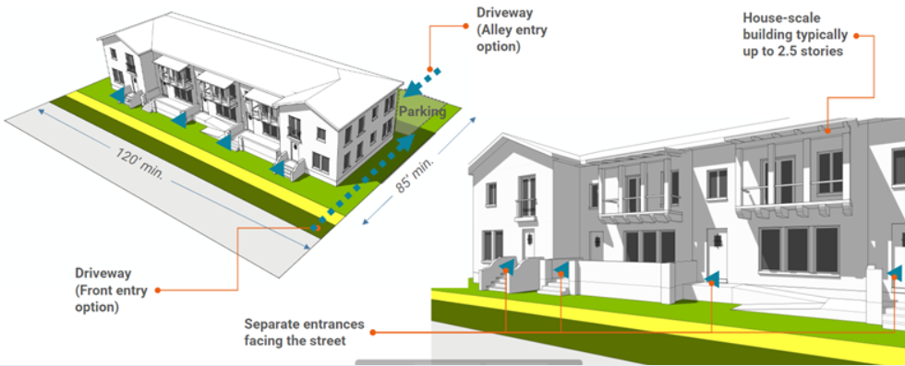
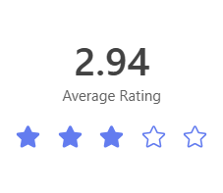
Townhouse
Buildings that contain three or more attached single-family dwelling units that extend from foundation to roof and that have a yard or public way on not less than two sides.

Slide 13
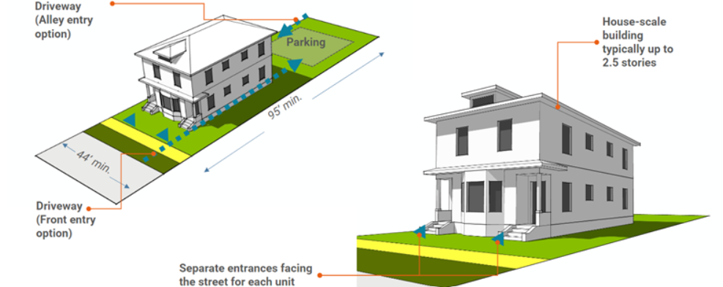
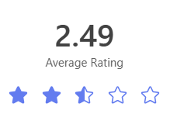
Stacked Flats
Dwelling units in a residential building of no more than three stories on a residential zoned lot in which each floor may be separately rented or owned.

Slide 14
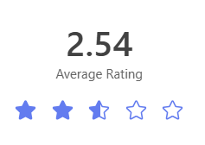
Courtyard
Apartments
Attached dwelling units arranged on two or three sides of a yard of court.

Slide 15
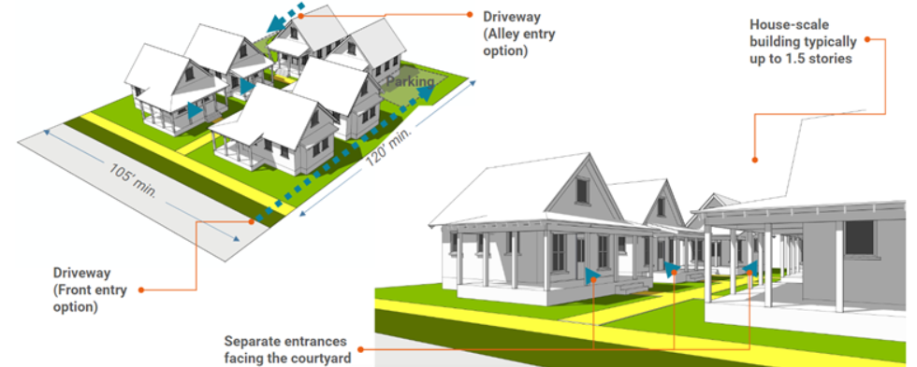
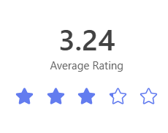
Cottage
Housing
Residential units on a lot with a common open space that either: (a) Is owned in common; or (b) has units owned as condominium units with property owned in common and a minimum of 20 percent of the lot size as open space.

Slide 16
Housing Types | Approval Comparison
Strongly Approve
Approve
Neutral
Disapprove
Strongly Disapprove

Slide 17
Building Height
I am comfortable with a _______story building in my neighborhood.
Favorable
Neutral
Unfavorable
Three
Story
Favorable
Unfavorable
Four
Story

Slide 18
Open Ended Comments | Summary
171
Reponses
General Sentiment | Top Concerns Expressed | Support for Middle Housing
Majority Opposition: Resistance to higher density, concern for property value. | Traffic and Infrastructure: Increased congestion, limited parking, water supply and adequate utility connections. | More Housing variety could meet diverse needs.
Minority Support for: ADUs. duplexes and cottage housing. | Affordability: Skepticism about middle housing being more affordable. | Favor smaller home options.
Frustration: Concern over developer driven decisions. | Environment: Concerns about tree loss and preserving green space. | Appreciation and support for innovative solutions, compatible with neighborhood character.

Slide 19
Staff Recommendation
Housing Types
Currently allowed
Duplex
Triplex
Townhouses
Cottage Houses
Include
Fourplex
Stacked Flats
Does the Planning Commission Align with the Recommendation?
Notes:
Does Planning Commission Align with this direction? This will help inform our DRAFT language, code revisions and updates and DRAFT Ordinance

Slide 20
Next Steps | Staff
Provide PC with survey results from open-ended comments.
Begin DRAFT language for LMC updates.
Begin DRAFT language for Citywide Middle Housing Ordinance.

