Slide 1
Comp Plan Rezone Requests
Planning Commission | March 12th, 2025

Slide 2
Rezone Requests

Slide 3
Amendment Process
Step One: Discussion with Staff
Is an amendment best option in pursuing desired outcome
Identification of hurdles → likelihood of success
Step Two: Request for Consideration
State Law: Amendments only once a year
Council decision to include/not include on docket
Screening out applications that have little chance of Council approval
Step 3: Submitting a Formal Application
Planning Commission review, public noticing, and hearing
Staff analysis, agency comments, public testimony
Planning Commission recommendation to Council
City Council work-session and formal action

Slide 4
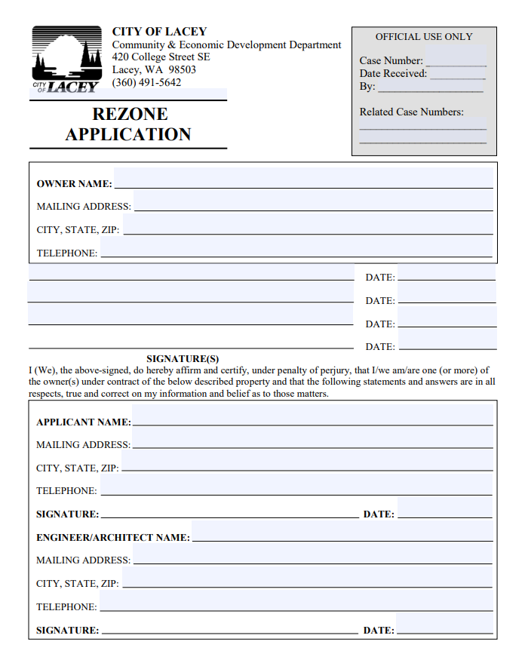
Application Criteria
Site details
Compatibility with adjacent uses
Challenges with existing zoning designation
How would a zoning change address identified challenges?
Availability of existing and proposed land under each zoning designation
Consistency with other plans
Comprehensive Plan(s)
Growth Management Act
County-Wide Planning Policies
Regional Transportation Plan
List of Adjacent Property Owners

Slide 5
Survey Summary

Slide 6
Outreach Overview
Timeline
July 2024 → March 2025
Distribution
City Website, Planning Counter, Social Media, Community Events, 2024 Community Survey
Submittals (to date)
48 Requests Submitted
Rezoning Workshop Link

Slide 7
Draft Evaluation Criteria

Slide 8
Rubric: Pass/Fail
# | Criteria | Fail/Score 0 | Pass/Score 4
1. | Within City | Property is outside city limits. | Property is within city limits.
2. | Active Code Violations/Issues | Existing violations or unresolved issues. | No violations present.
3. | Written Request from Owner | No written request from owner. | Written request from owner.
4. | Reduction in Land Use/Capacity (Excluding OSI) | Rezone reduces development potential. | Rezone maintains or increases development potential.
5. | Identified as City Priority | Not an identified city priority | Identified city priority

Slide 9
Rubric: Point Values
# | Criteria | Score 0 | Score 1 | Score 2 | Score 3 | Score 4
1. | Amount of Current and Proposed Zoned Undeveloped Land Available | No undeveloped land available for existing zoning. | Limited undeveloped land available for existing zoning. | Adequate undeveloped land for existing zoning. | Sufficient undeveloped land for current zoning. | Significant undeveloped land available for existing zoning.
2. | Unusable Under Current Designation | Property is optimal for current zoning. | Property is usable under current zoning. | Property can be used under current zoning with some limitations. | Property is somewhat restricted or limited in use under current zoning. | Property is completely unusable under current zoning.
3. | Spot Rezone/Adjacent Use Consistency | Rezone is inconsistent with adjacent uses. |  | Rezone is somewhat consistent with adjacent uses. |  | Rezone is consistent with adjacent land uses and surrounding zoning.
4. | Critical Areas | Property contains significant critical areas (e.g., wetlands, flood zones). | Property contains some critical areas that require mitigation. | Property contains minimal critical areas, and mitigation is manageable. | Property has very few or no critical areas, but some minor considerations remain. | Property has no critical areas or environmental restrictions.
5. | Consistency with Comp Plan | Rezone is inconsistent with comp plan goals and policies. |  | Rezone is somewhat consistent with comp plan goals and policies. |  | Rezone is fully consistent with the comp plan goals and policies.
6. | Transportation/ Infrastructure Available | Transportation/infrastructure is insufficient to support the proposed use. | Infrastructure access is limited or constrained. | Infrastructure is somewhat sufficient but may require improvements. | Infrastructure is mostly sufficient to support the proposed use. | Infrastructure is capable of supporting the proposed use.

Slide 10
Rubric: Point Values
How to Use the Rubric:
Score 0: Major issues or inconsistencies.
Score 1: Some concerns, but not critically problematic.
Score 2: Meets most expectations with moderate concerns or limitations.
Score 3: Aligns well with the criteria, few concerns or minor issues.
Score 4: Fully meets or exceeds expectations with no significant issues.

Slide 11
Rubric: Point Values
Criteria | Score 0 | Score 1 | Score 2 | Score 3 | Score 4
Amount of Current and Proposed Zoned Undeveloped Land Available | No undeveloped land available for existing zoning. | Limited undeveloped land available for existing zoning. | Adequate undeveloped land for existing zoning. | Sufficient undeveloped land for current zoning. | Significant undeveloped land available for existing zoning.

Slide 12
Rubric: Point Values
Criteria | Score 0 | Score 1 | Score 2 | Score 3 | Score 4
Unusable Under Current Designation | Property is optimal for current zoning. | Property is usable under current zoning. | Property can be used under current zoning with some limitations. | Property is somewhat restricted or limited in use under current zoning. | Property is completely unusable under current zoning.

Slide 13
Rubric: Point Values
Criteria | Score 0 | Score 1 | Score 2 | Score 3 | Score 4
Spot Rezone/Adjacent Use Consistency | Rezone is inconsistent with adjacent uses. | - | Rezone is somewhat consistent with adjacent uses. | - | Rezone is consistent with adjacent land uses and surrounding zoning.

Slide 14
Rubric: Point Values
Criteria | Score 0 | Score 1 | Score 2 | Score 3 | Score 4
Critical Areas | Property contains significant critical areas (e.g., wetlands, flood zones). | Property contains some critical areas that require mitigation. | Property contains minimal critical areas, and mitigation is manageable. | Property has very few or no critical areas, but some minor considerations remain. | Property has no critical areas or environmental restrictions.

Slide 15
Rubric: Point Values
Criteria | Score 0 | Score 1 | Score 2 | Score 3 | Score 4
Consistency with Comp Plan | Rezone is inconsistent with comp plan goals and policies. | - | Rezone is somewhat consistent with comp plan goals and policies. | - | Rezone is fully consistent with the comp plan goals and policies.

Slide 16
Rubric: Point Values
Criteria | Score 0 | Score 1 | Score 2 | Score 3 | Score 4
Transportation/ Infrastructure Available | Transportation/infrastructure is insufficient to support the proposed use. | Infrastructure access is limited or constrained. | Infrastructure is somewhat sufficient but may require improvements. | Infrastructure is mostly sufficient to support the proposed use. | Infrastructure is capable of supporting the proposed use.

Slide 17
Next Steps

Slide 18
Rezone Request Evaluation
Scoring Summary:
--- points: Strong case for approval.
--- points: May require additional review or conditions.
--- points: Concerns that need to be addressed.
Below --- points: Significant issues.
Follow Up Meeting: Prioritized List of Rezone Requests
Carried forward as part of Comprehensive Plan Update
Recommended for greater review

