Slide 1
Land Use
City Council Worksession | February12th, 2025

Slide 2
Legislative Updates

Slide 3
Requirements for 2025
Land Use Element
Estimates of population densities and building intensities based on future land uses and housing needs.
Identification of lands for public purposes such as utility corridors, transportation corridors, recreation, schools and other public uses.
Strategies that increase physical activity and reduce per capita vehicle miles traveled.
Provisions for protection of the quality and quantity of groundwater used for public water supplies.
Consistent with County Wide Planning Policies

Slide 4
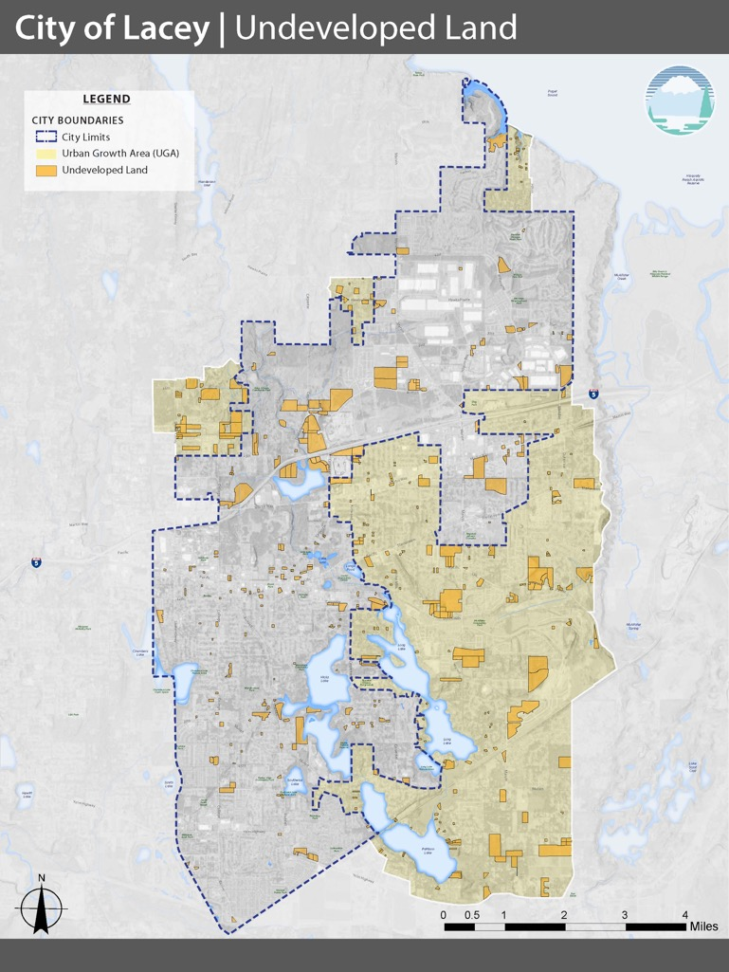
Land Capacity
TRPC Buildable Lands Report
Is there sufficient land in our urban areas for 20 years of growth?
Are we achieving urban densities for new development in urban areas? (4/acre)
Thurston Climate Mitigation Plan: 72% of urban area housing within ½ mile of city centers, corridors, or neighborhood centers? (No – Currently at 57%)
Middle Housing (HB 1110)
Two units per residential lot
Four units per lot if at least one unit is affordable
4/lot within ¼ mile walking distance of a major transit stop

Slide 5
Community Feedback

Slide 6
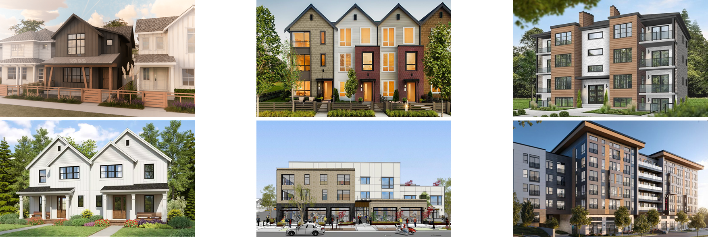
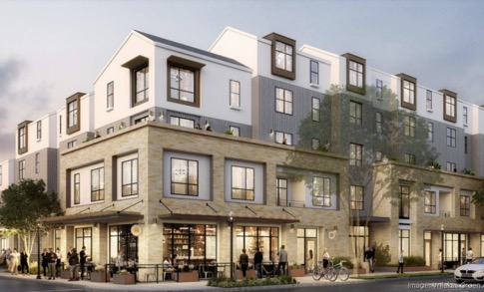
Geobudgeting: Residential
Where will new homes go?
Current projections show 20,000 more people moving to the area over the next 20 years. With this in mind, Lacey must find space for approximately 8,250 new homes.
Detached Homes
Townhomes
Small Multifamily
Duplex / Triplex
Mixed Use
Larger Multifamily

Slide 7
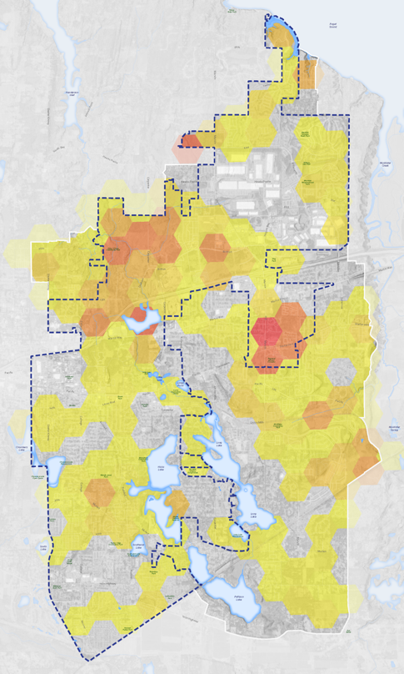
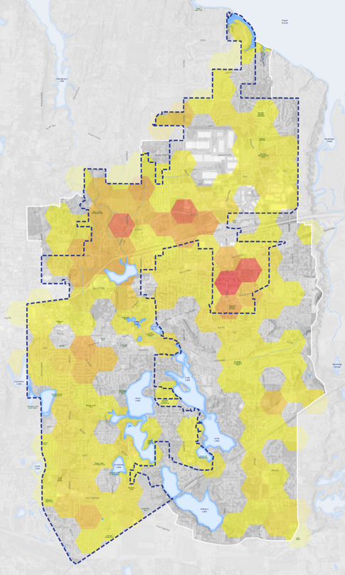
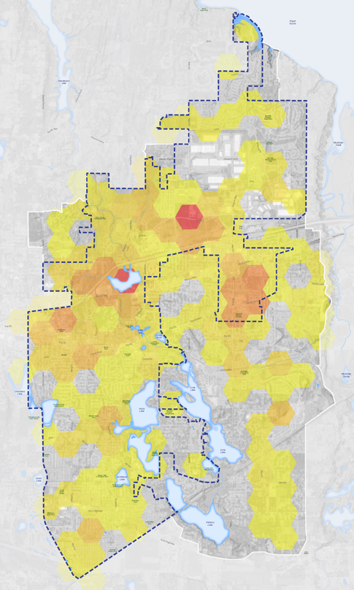
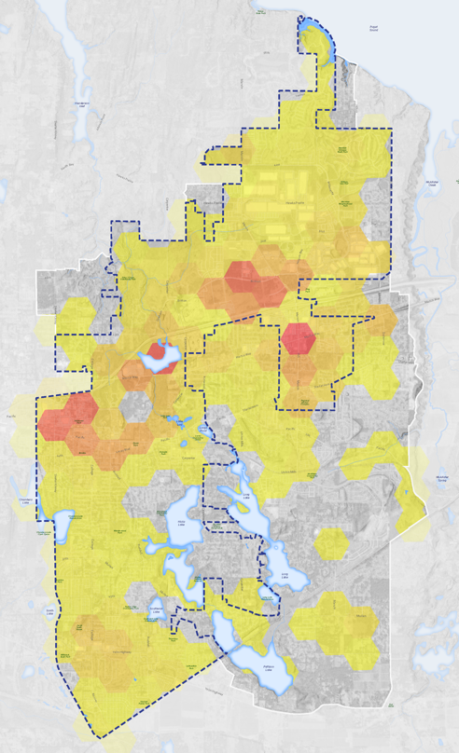
Geobudgeting: Residential
Detached Homes / Duplex
Townhomes
Multifamily
Mixed use

Slide 8
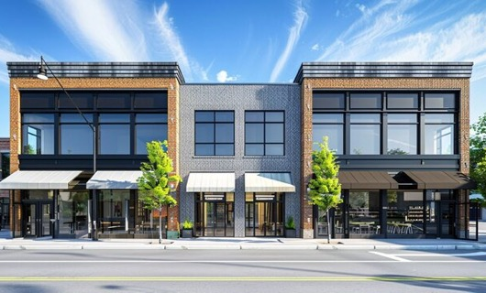
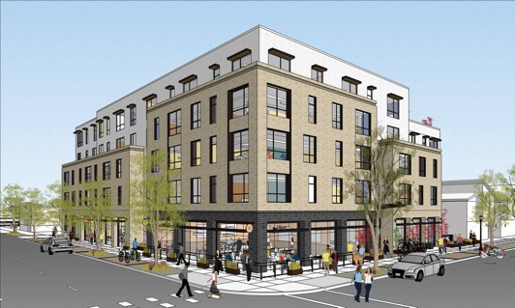
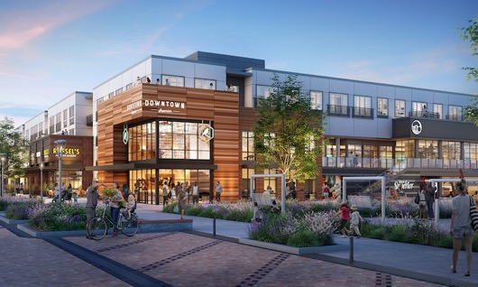
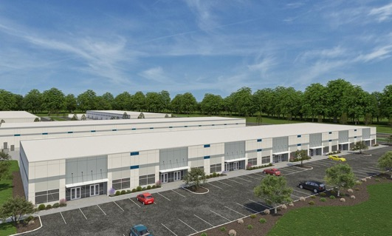
Geobudgeting: Commercial
Where will new jobs go?
Current projections show 20,000 more people moving to the area over the next 20 years. With this in mind, Lacey must find space for approximately 9,000 new jobs.
Mixed Use
(homes over businesses)
Commercial
Larger
Commercial Center
Light
Industrial

Slide 9
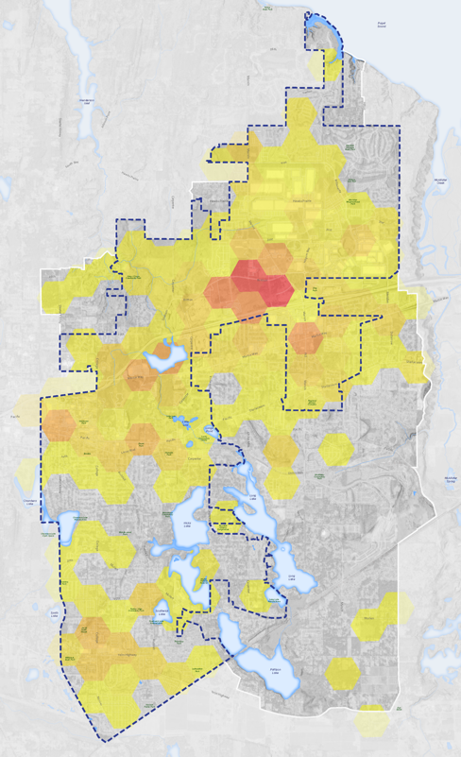
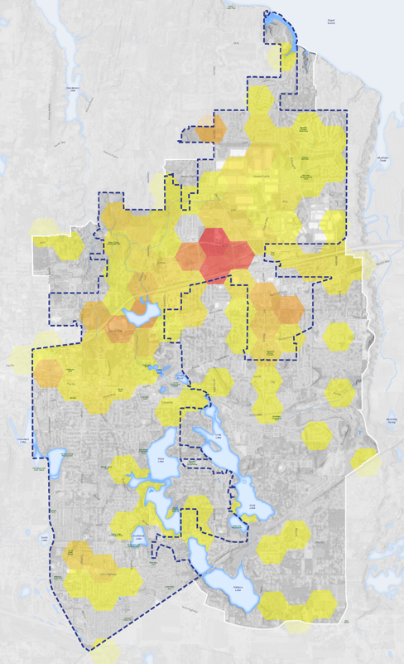
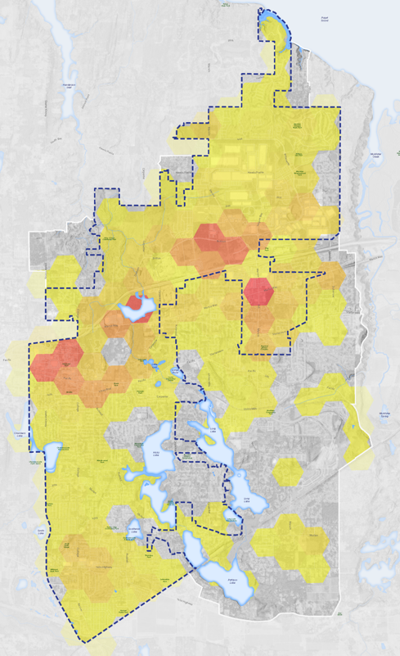
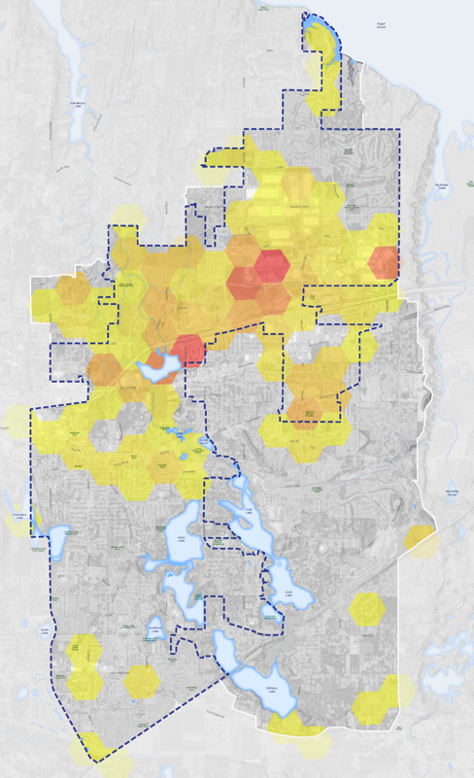
Geobudgeting: Commercial
General Commercial
Large Commercial Centers
Mixed Use
Light Industrial

Slide 10
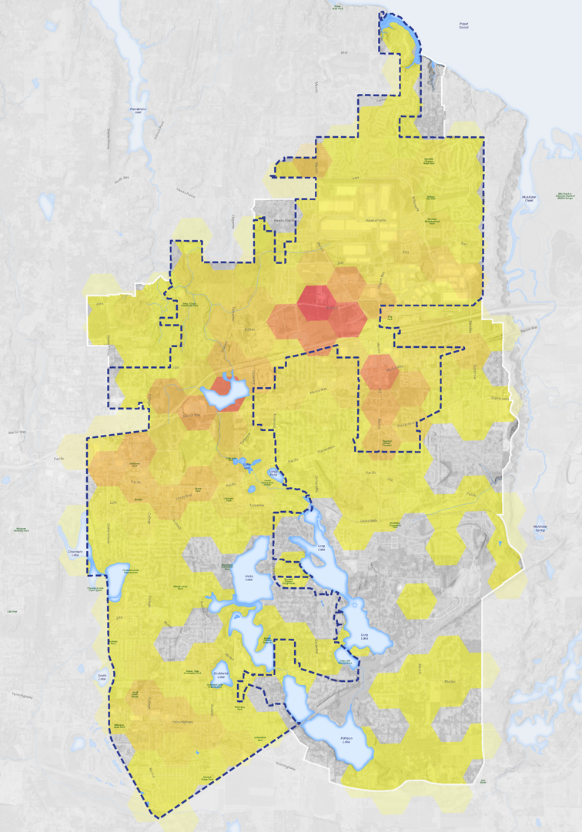
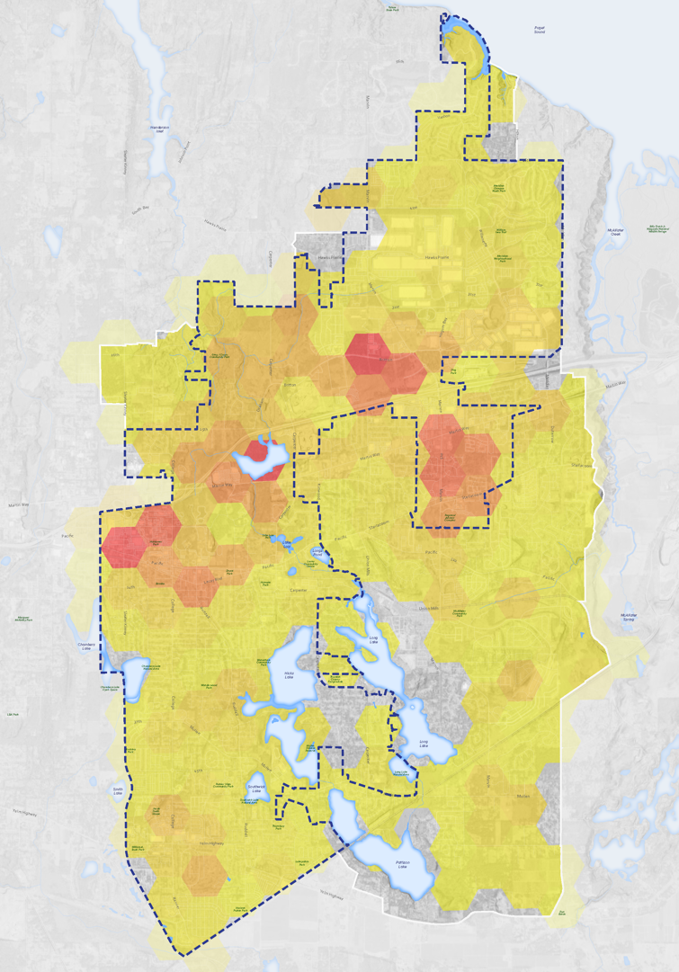
Commercial
Residential
41st & Marvin NCD
NTSD Future Site
Cabela’s &
Quiemuth Village
Woodland Creek Wetlands
RAC &
Nisqually MS
Geobudgeting: Combined
South
Sound Center
College St
Yelm Hwy

Slide 11
Future Land Use Maps

Slide 12
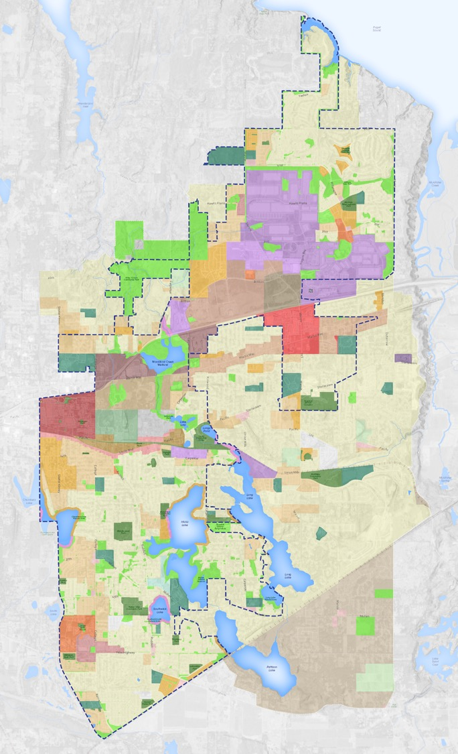
Map Types
Future Land Use Map
Identifies the general location and intensity of land uses
Implements goals and vision of the Comprehensive Plan (20yrs)
5 land use designations
Zoning Map
Identifies the currently permitted uses of a specific property
Title 16 of Lacey Municipal Code (34 zoning designations)
Implements the Future Land Use Map

Slide 13
Comprehensive Plan
Current Approach
Future Land Use & Zoning Map adopted into 2016 Comprehensive Plan as a single map
Requires all proposed zoning changes to be routed through the Legislative Review Process (Approx. Review Time: 6 to 9 months)
Proposed Approach
Future Land Use Map to be adopted into 2025 Comprehensive Plan
Only changes to Future Land Use Map would require Legislative Review
Can reduce review time of rezone requests consistent with FLUM

Slide 14
FLU Maps
Current Conditions (no change) Alternative
Land uses based on current conditions. Future Land Use Map would mirror existing mixed-use zoning designations.
Residential Alternative
Land uses would support residential uses within more areas of the city. Map would prioritize expanded housing options over other potential uses.
Commercial Alternative
Land uses would support commercial uses within more areas of the city. Map would ensure key locations and transportation corridors are maintained for commercial uses and future job growth.

Slide 15
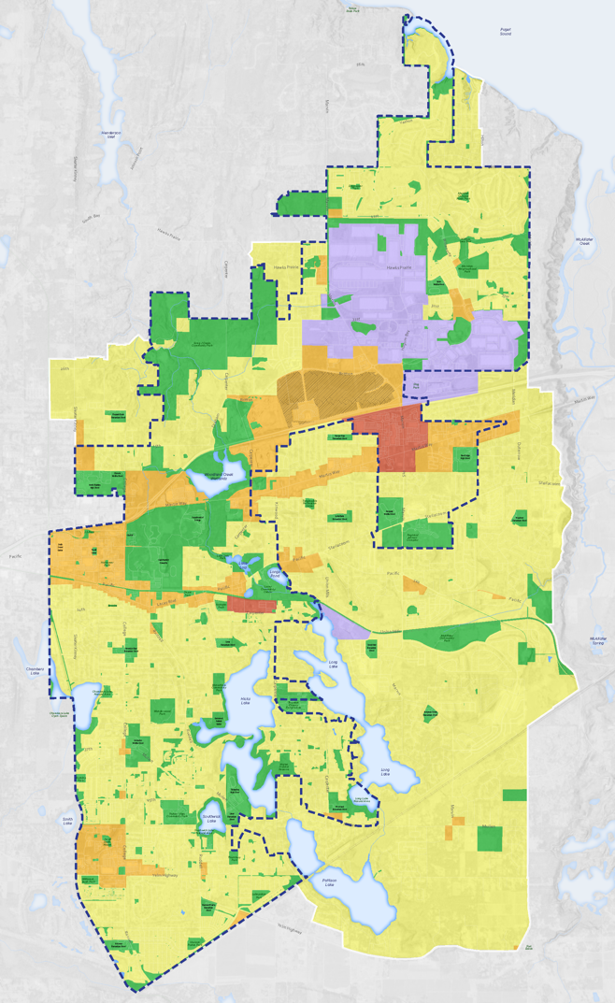
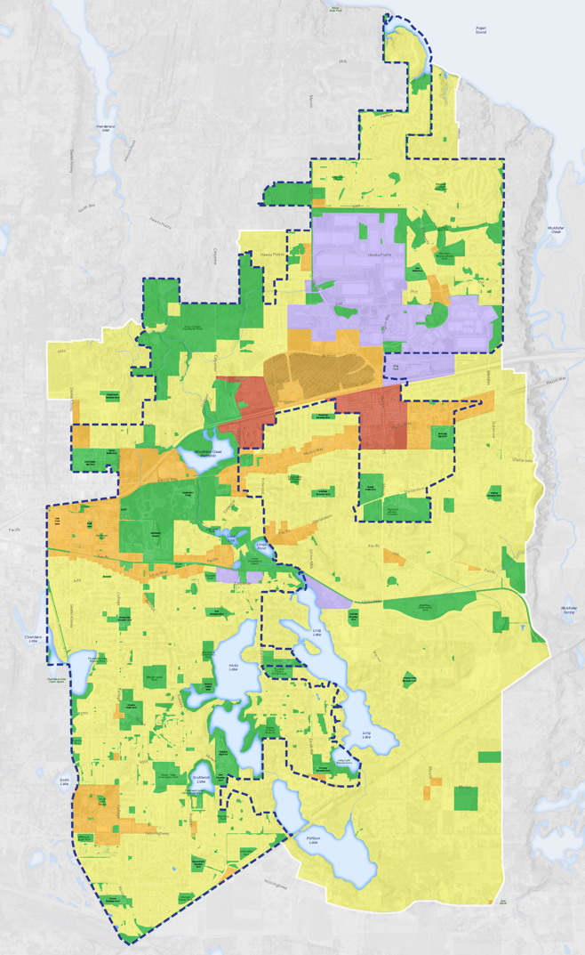
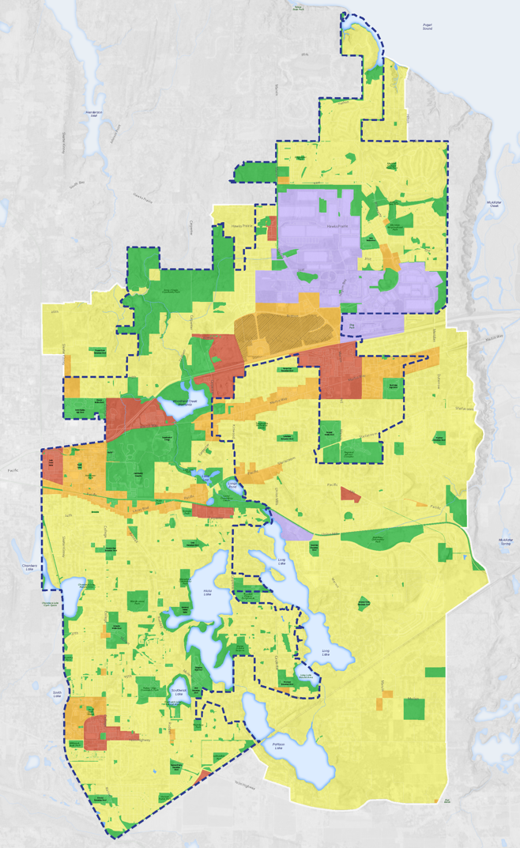
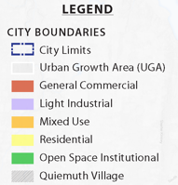
Current Conditions Alternative
Residential Alternative
Commercial Alternative
41st & Marvin NCD
NTSD Future Site
Cabela’s &
Quiemuth Village
RAC &
Nisqually MS
South
Sound Center
City Hall &
Saint Martin’s
College St
Yelm Hwy

