Slide 1
Lacey Climate Element
February 11, 2025

Slide 2
HB 1181: Climate Change Planning
Purpose:
Improve the State’s response to climate change by updating the State’s planning framework.
Goals:
Reduce sprawl
Encourage multi-modal transportation systems
Reduce Vehicle Miles Traveled (VMT)
Reduce greenhouse gas (GHG) emissions
Retain open space and enhance those spaces
Plan for climate resiliency

Slide 3
Climate Element
  Per the mandate from HB-1181, the city will create a new climate element that contains two sub-elements:
  GHG Emissions Reduction Sub-element (Mitigation)
  Climate Resiliency Sub-Element (Adaptation)

Slide 4
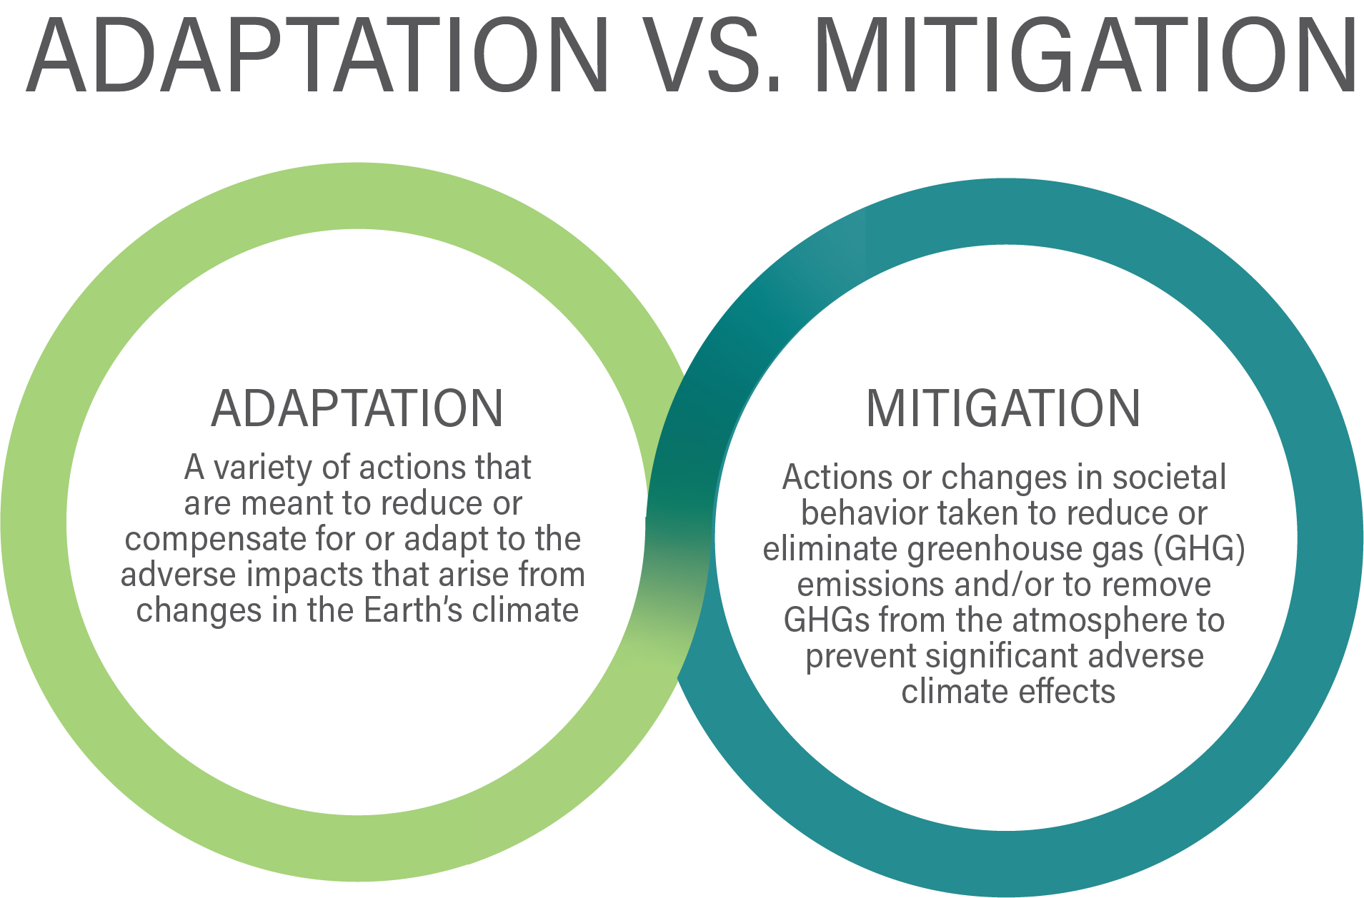
Climate Element

Slide 5
GHG Sub-element Requirements
Requirement 1: Result in reductions in overall greenhouse gas emissions generated by transportation and land use within the jurisdiction but without increasing emissions elsewhere in Washington:
Requirement 2: Result in reductions in per capita vehicle miles traveled within the jurisdiction but without increasing greenhouse gas emissions elsewhere in Washington; and,
Requirement 3: Prioritize reductions that benefit overburdened communities in order to maximize the co-benefits of reduced air pollution and environmental justice.

Slide 6
Interdepartmental Climate Team
  This team is comprised of various city departments and will work on editing, creating, and approving goals/policies for adoption to the comprehensive plan.
  Public Works
  City Managers Office
  CED
  Parks and Recreation
  Facilities
  Emergency Management

Slide 7
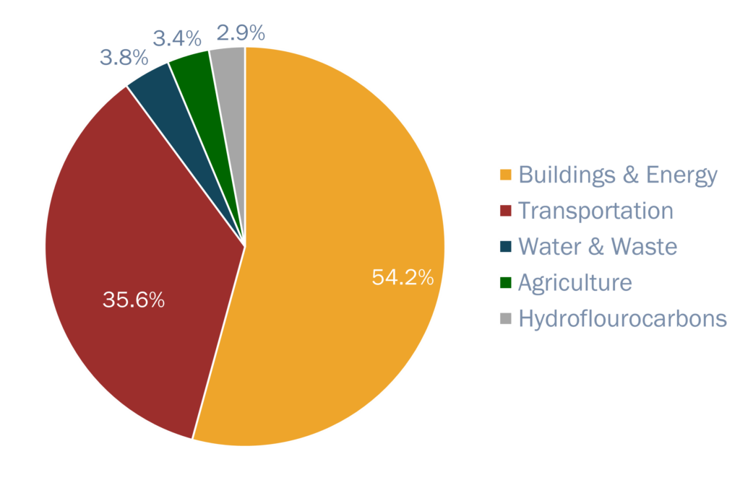
2022 Thurston County GHG Inventory

Slide 8
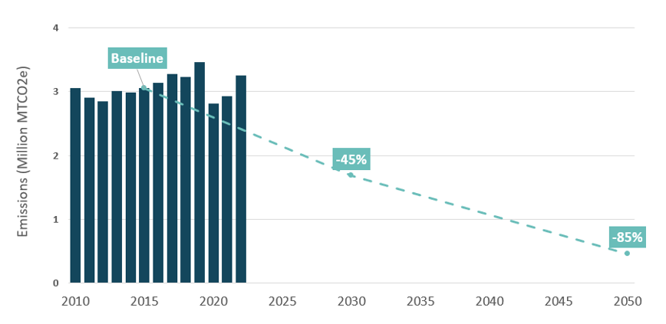
TCMP Goals

Slide 9
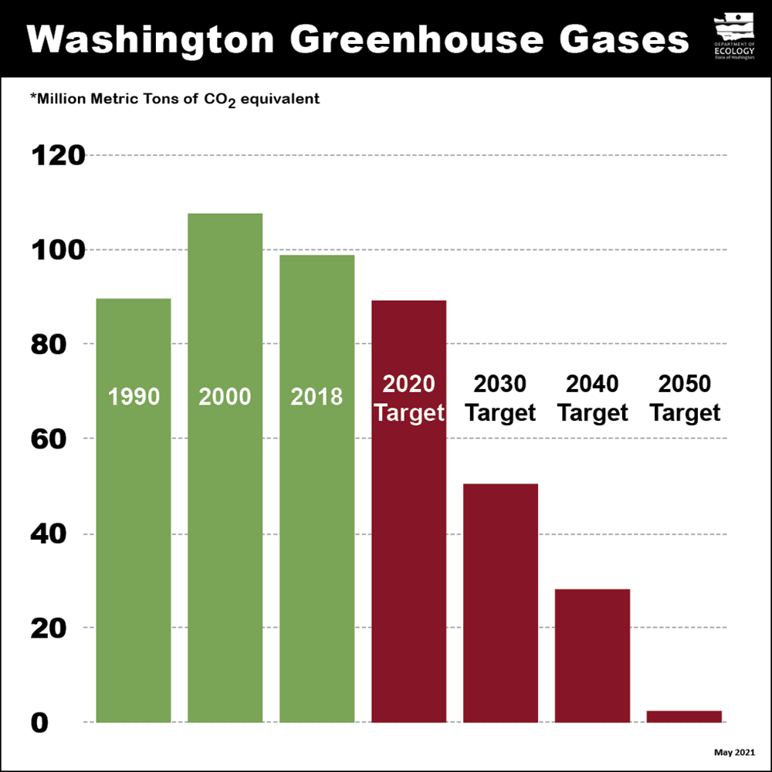
GHG Emissions Reduction Goals
2035- 45% below 2022 level
2040 – 75% below 2022 levels
2050 – Achieve net zero

Slide 10

GHG Sub-element Steps to Adoption
Step 3: Develop Measures and Implementation Plan to Achieve Targets
  Utilize TCMP and Commerce's Menu of Measures to reach target goals.
  Present the data results (inventory) and goals to the community with the opportunity for engagement and feedback.
Step 4: Integrate Measures into Plan and Evaluate Progress
  Utilize our internal staff team and climate staff team to integrate these GHG reduction goals and policies into the comprehensive plan.
  Set GHG inventory update guidelines/timeframe to gauge progress toward goals and policies.

Slide 11
Lacey Resilience
Sub-Element
February 11, 2025
Notes:
Ron
Thank you, Ryan, Hans, and Linsey. Good evening commissioners.
My name is Ron Whitmore, and I’m a Principal with Raimi + Associates. Raimi + Associates is working with City staff and the Climate Team to prepare the Resilience Sub-Element.
I’ve been working in community sustainability for over 30 years across all sectors, including 13 years as a long-range planner and sustainability director in local government. For Raimi + Associates, I manage a mix of comprehensive plan updates and climate planning.

Slide 12
Consultant Team
Raimi + Associates
Ron Whitmore
Principal-in-Charge
Robyn Wong
Project Manager and Climate Adaptation Analysis and Policy
+ GIS and engagement support staff
  Mission: Working collaboratively with our clients, R+A channels our passion and expertise to foster healthy, equitable, and resilient communities.
  Services: comprehensive plans, climate plans, environmental justice policy, master plans, zoning codes, design standards, green building, health policy, engagement, social research, program evaluation.
  Staff: highly collaborative, nimble, 24-person staff.

Slide 13
Resilience Sub-Element Overview

Slide 14
Resilience Sub-Element Purpose
Purpose:
Equitably enhance resiliency to avoid or reduce the adverse impacts of climate change in human communities and ecological systems through goals, policies, and programs consistent with credible science.
Objectives:
Address natural hazards created or aggravated by climate change.
Identify, protect, and enhance natural areas.
Consider social, economic, and built environment factors to support adaptation consistent with environmental justice.
Prioritize actions that benefit overburdened communities.

Slide 15
Project Scope
Technical Analysis: Assess existing plans and policies; assess climate vulnerabilities.
Develop Policies: Develop a framework of adaptation and resilience policies.
Comprehensive Plan Amendments: Prepare the Resilience Sub-Element (including multiple drafts and public review).
Code Audit: Identify City code that will need to be amended to align with the Comprehensive Plan Amendment.
Engagement throughout in partnership with the City and MIG

Slide 16
Workplan
 | 2024 |  |  |  | 2025
Task | Sept | Oct | Nov | Dec | Jan | Feb | Mar | Apr | May | Jun
Project Kickoff & Data Assembly
Resilience Sub-Element Factsheet
Comp Plan Online Survey
Listening Sessions
Plan + Policy Audit
Vulnerability and Risk Assessment
Policy Framework
Comp Plan Public Workshop
Public Draft Comp Plan Amendments
Code Audit
Blue: Technical Work
Orange: Community Engagement
Resilience Sub-Element adoption will proceed with the other Comp Plan updates.

Slide 17
Work Completed to Date

Slide 18
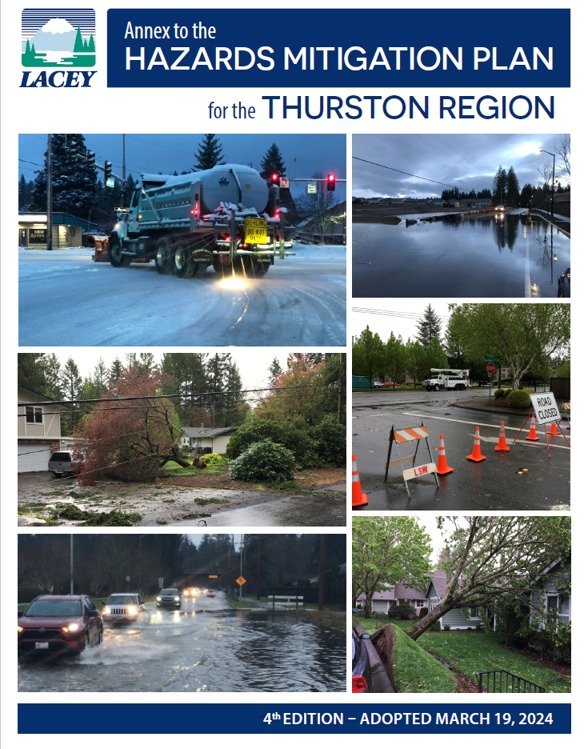
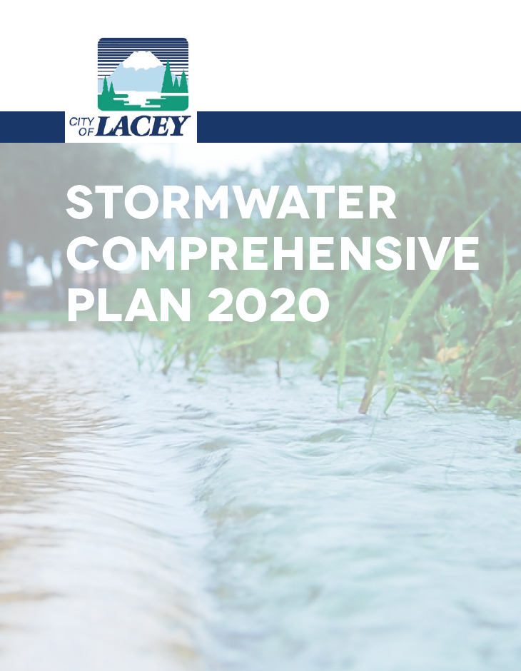

Plan and Policy Audit
Review of climate goals and policies in existing City plans to understand gaps and opportunities to incorporate climate resilience.
Key findings
  Incorporate policies from the Lacey Annex to the Thurston County Hazard Mitigation Plan.
  Consolidate detailed policies in existing departmental plans into higher-level resilience policies.
  Add measures to address heat and wildfire impacts.
  Prioritize measures to increase the resilience of vulnerable communities.
Notes:
Robyn
As I mentioned earlier, we complete two foundational sets of analysis so that we can ultimately develop an implementable plan.
The Plan and Policy Audit (which we’ve provided a summary of in your packet) gives us an understanding of the City’s existing policy landscape.
We reviewed eight plans, including all elements of 2016 comp plan, the county hazard mitigation plan and city annex, other plans related to infrastructure and facilities.
Through this analysis we have found that the City already has policies from other plans which should be consolidated into the Resilience Sub-Element.
Areas that we intend to strengthen are policies about heat and wildfire, as well as prioritizing measures that increase the resilience of vulnerable communities.

Slide 19
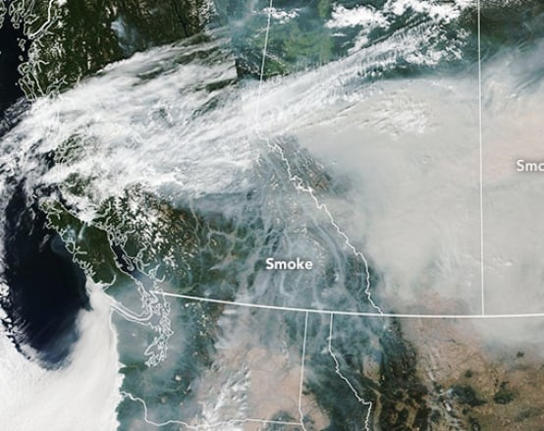
Vulnerability and Risk Assessment
Mapping and data indicate Lacey faces low risk from climate hazards like flooding, sea level rise, wildfire, and extreme heat.
Impacts:
  Higher temperatures and heat wave events.
  Observed increase in damaging wet microburst storms with extreme winds.
  Wildfire smoke from wildfires outside of the city.
Smoke from B.C. wildfires in 2018

Slide 20
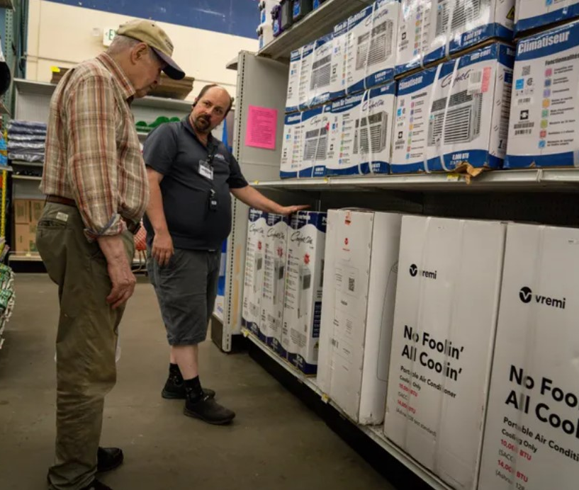
Vulnerability and Risk Assessment
Vulnerability and risk to hazards is increased by population and building characteristics, such as:
  Age (older adults and children), income, language access.
  Buildings without air conditioning.
  Mobile/manufactured homes.

Slide 21
Policy Framework (in progress)
Identifies an initial set of Resilience Sub-Element goals and policies for discussion with City staff.
Adapts existing goals and policies from City plans and recommends new ones.
Plan and Policy Audit
Climate Vulnerability and Risk Assessment
Community Engagement
Admin Draft Policy Framework

Slide 22
Engagement
Notes:
Robyn
Now I’ll provide an overview of the work that we’ve completed do date

Slide 23
Listening Sessions
We heard from:
Realtors
Climate advocates
Organizations representing vulnerable populations
Key findings:
Increase resilience to heat and wildfire smoke.
Power outages will exacerbate risks during climate hazard events.
Improve communication about climate change, especially anticipated heat and health impacts.
Pursue nature-based solutions.
Notes:
Robyn
We are supplementing our technical analysis by holding listening sessions with community stakeholders.
These sessions are an important source of local knowledge and help us understand and how people experience the impacts of climate change in their lives and work.
While we have already completed some of our sessions, we anticipate having an ongoing dialogue with community members with different perspectives throughout the project. We have spoken to folks representing real estate interests, climate advocates, and we are going to have session with organizations that represent populations including youth and lower-income residents.
Now I’ll pass it back to Ron to go over next steps
Real Estate Interests
Thurston County Realtors Association
Climate Advocates
Thurston Climate Action Team
Evergreen State College Center for Climate Action and Sustainability
Vulnerable Populations
Nisqually River Education Project – students and youth
Thurston County Food Bank

Slide 24
Survey

Slide 25
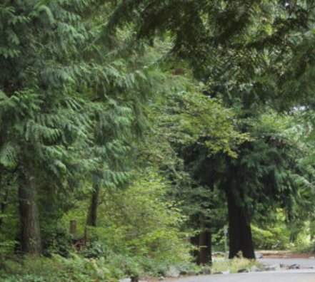
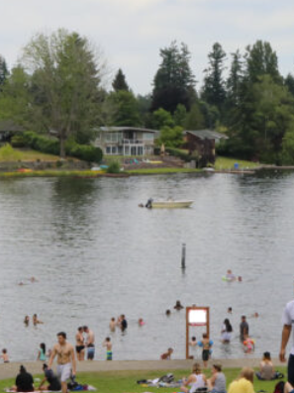
Survey
Protect natural resources including trees, lakes, and fauna
  “Neighborhood streets could use more shade/trees. The parks need sustainable water supply to keep the trees healthy”
  “…Natural green space home to eagles and deer”

Slide 26
Planning Commission and City Council Input
Notes:
Ron
Thank you, Robyn. The Planning Commission and City Council are important partners in this effort, so we wanted to give you a preview of what’s to come.

Slide 27
Planning Commission and Council Input
 | 2024 |  |  |  | 2025
Task | Sept | Oct | Nov | Dec | Jan | Feb | Mar | Apr | May | Jun
Project Kickoff & Data Assembly
Resilience Sub-Element Factsheet
Comp Plan Online Survey
Listening Sessions
Plan + Policy Audit
Vulnerability and Risk Assessment
Policy Framework
Comp Plan Public Workshop
Public Draft Comp Plan Amendments
Code Audit
Comp Plan PC/Council Joint Session: February 2025
Resilience Sub-Element Policy Frameworks: April 2025 Work Session
Resilience Sub-Element Public Draft Comp Plan Amendments: May – June 2025
Comp Plan Update Adoption: Fall – Winter 2025
Blue: Technical Work
Orange: Engagement
Star: PC and Council Touch Point
Notes:
Ron
As Robyn noted, we’ll soon transition from analysis to policy writing. Specifically, we look forward to discussing the draft Policy Framework with you in February and March. The Policy Framework will identify the goals and policies that will serve as the foundation for the Resilience Sub-Element.
Later in the spring, we’ll seek your input on the draft Sub-Element.
Thank you for the opportunity to introduce our work on the Resilience Sub-Element.
I’ll now turn it back over to Linsey and Ryan.

Slide 28
