Slide 1
Climate and Sustainability Update
City Council|April 1, 2025

Slide 2
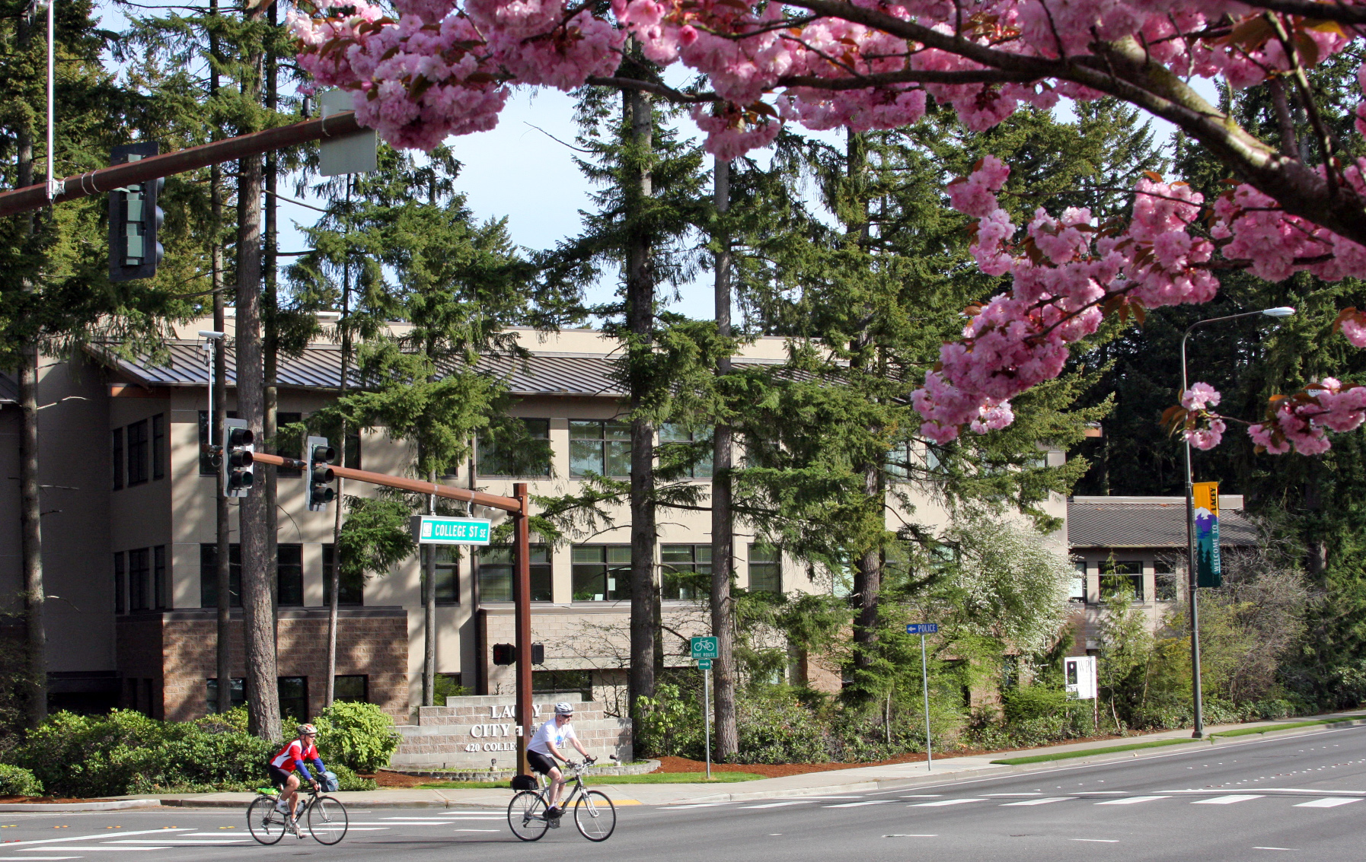
2025 Lacey Workplan
TCMC Jurisdiction Workplans
Workplans include 2025 climate and sustainability projects.
You can find workplans at https://thurstonclimatecollaborative.org/city-county-initiatives/
Lacey Workplan Sectors:
Energy and Buildings
Transportation
Water and Wastewater
Agriculture-Forests
Cross Cutting Sector

Slide 3
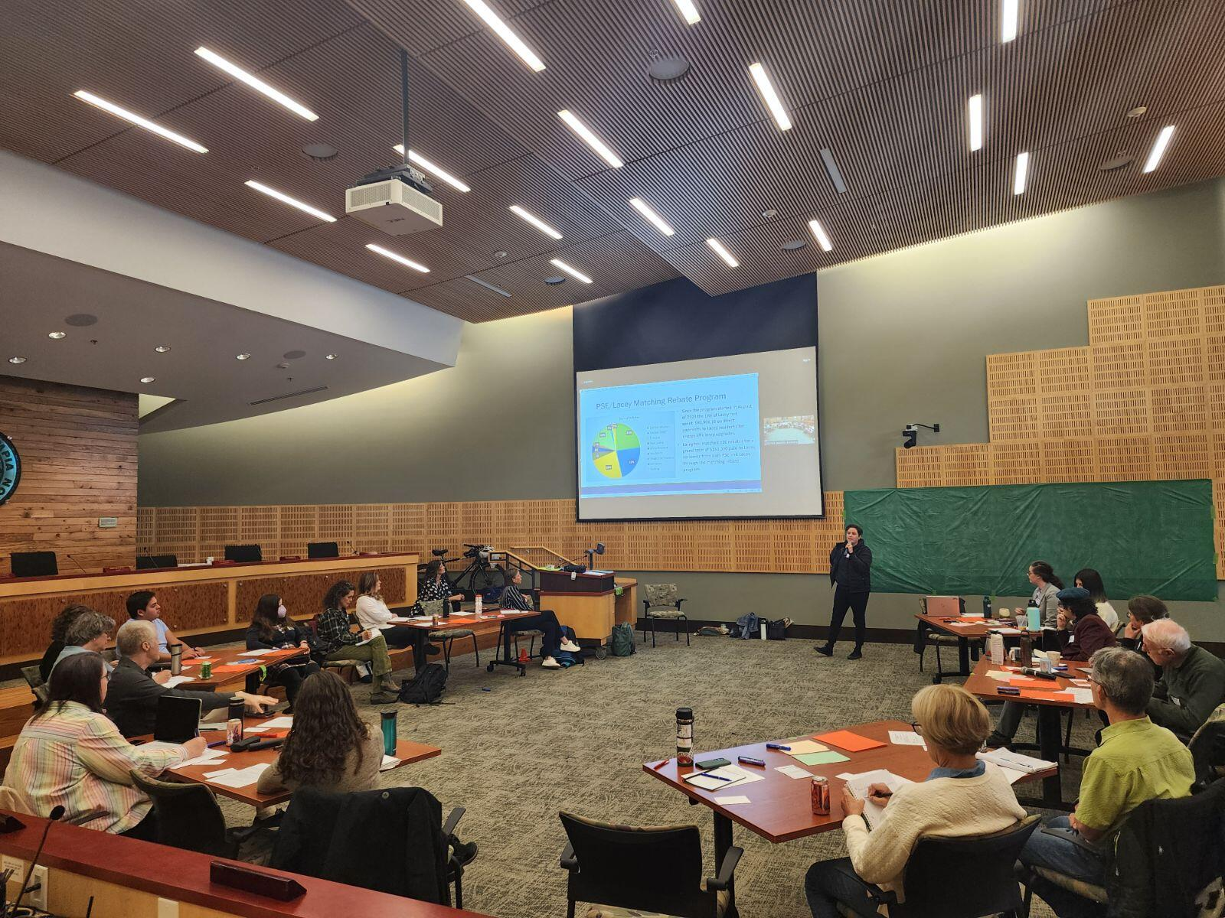
Thurston Climate Mitigation Collaborative
2024 Complete Regional Initiatives:
Energize Thurston moves forward to implementation.
Home Energy Score Program (HES)-a model ordinance was approved by the Executive Committee of the Thurston Climate Mitigation Collaborative (TCMC).
Each jurisdiction will move through government process.
Community and Economic Development (CED)Staff Team will place HES on 2026 workplan for council consideration.
2025-2026 Administrative Updates
TCMC Staff Team will start minor administrative updates.
These updates will be scoped during spring/summer of 2025.
Work with a consultant will start fall/winter 2025.

Slide 4
Energize Thurston
We have launched!
Lacey will host its workshop on April 22nd at 6:30 p.m. at Lacey Timberland Library.
Using HEAR funding Lacey will be able to help 40 homes.
22 fully-subsidized and 18 partially- subsidized.
An online workshop will be available, stay tuned for more.
Find more information and register at https://thurstonclimatecollaborative.org/regional-initiatives/energize-thurston/

Slide 5
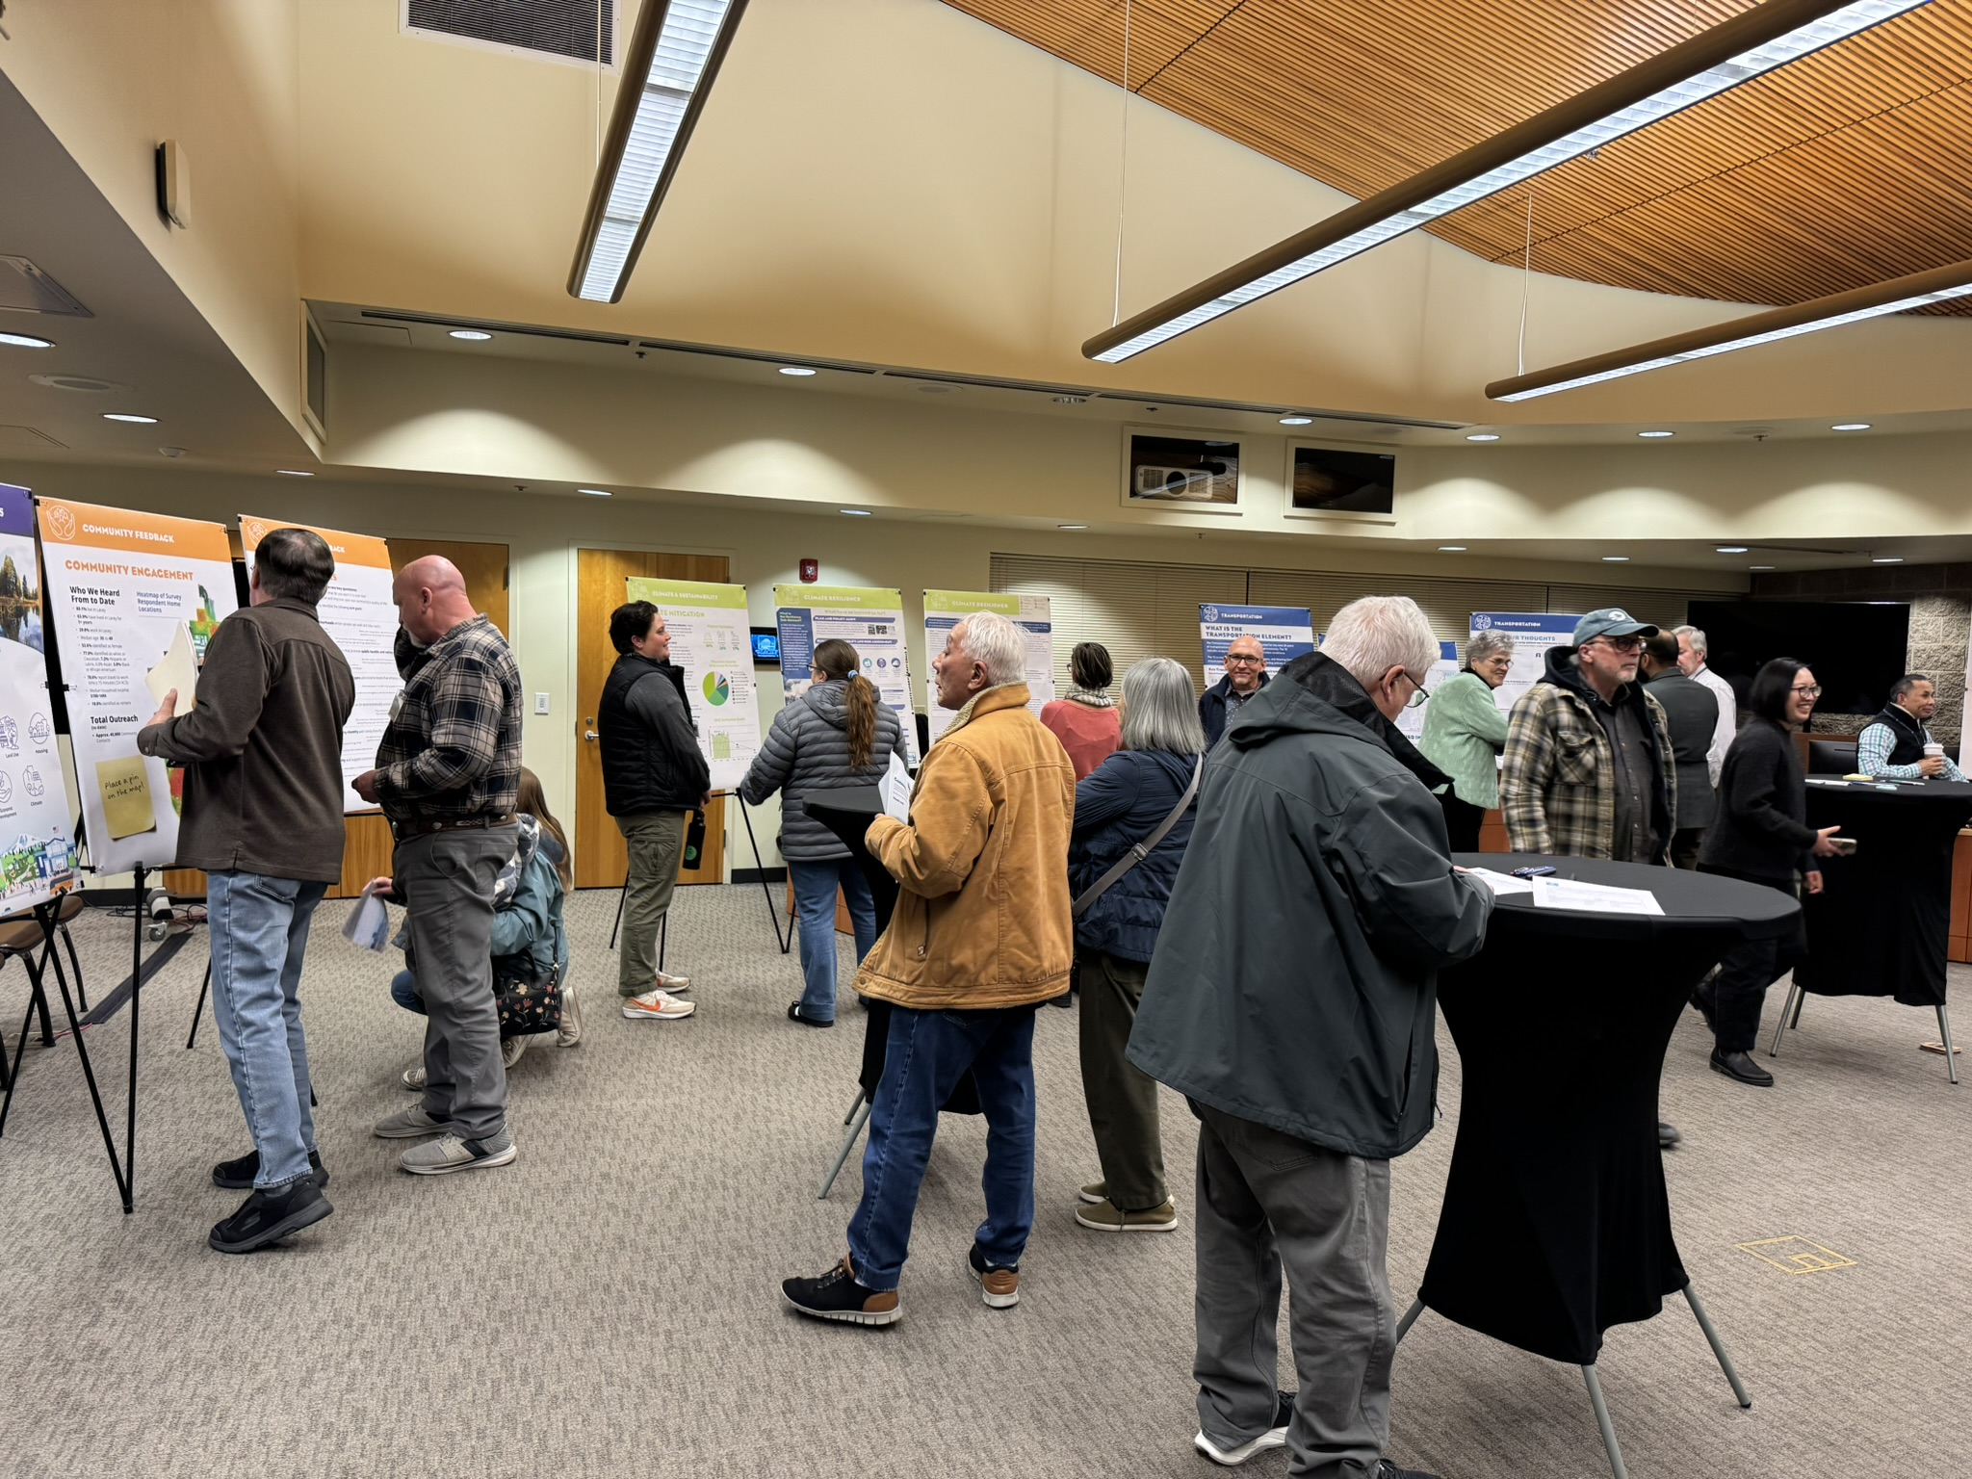
Comprehensive Plan Update
Draft Goals and Policies
The GHG Sub-Element draft goals and policies are being reviewed by staff.
The Climate Resilience Sub-Element draft goals and policies are completed.
Both elements had community input during our open house.
The City Council and Planning Commission will review both elements draft goals/policies this month.

Slide 6
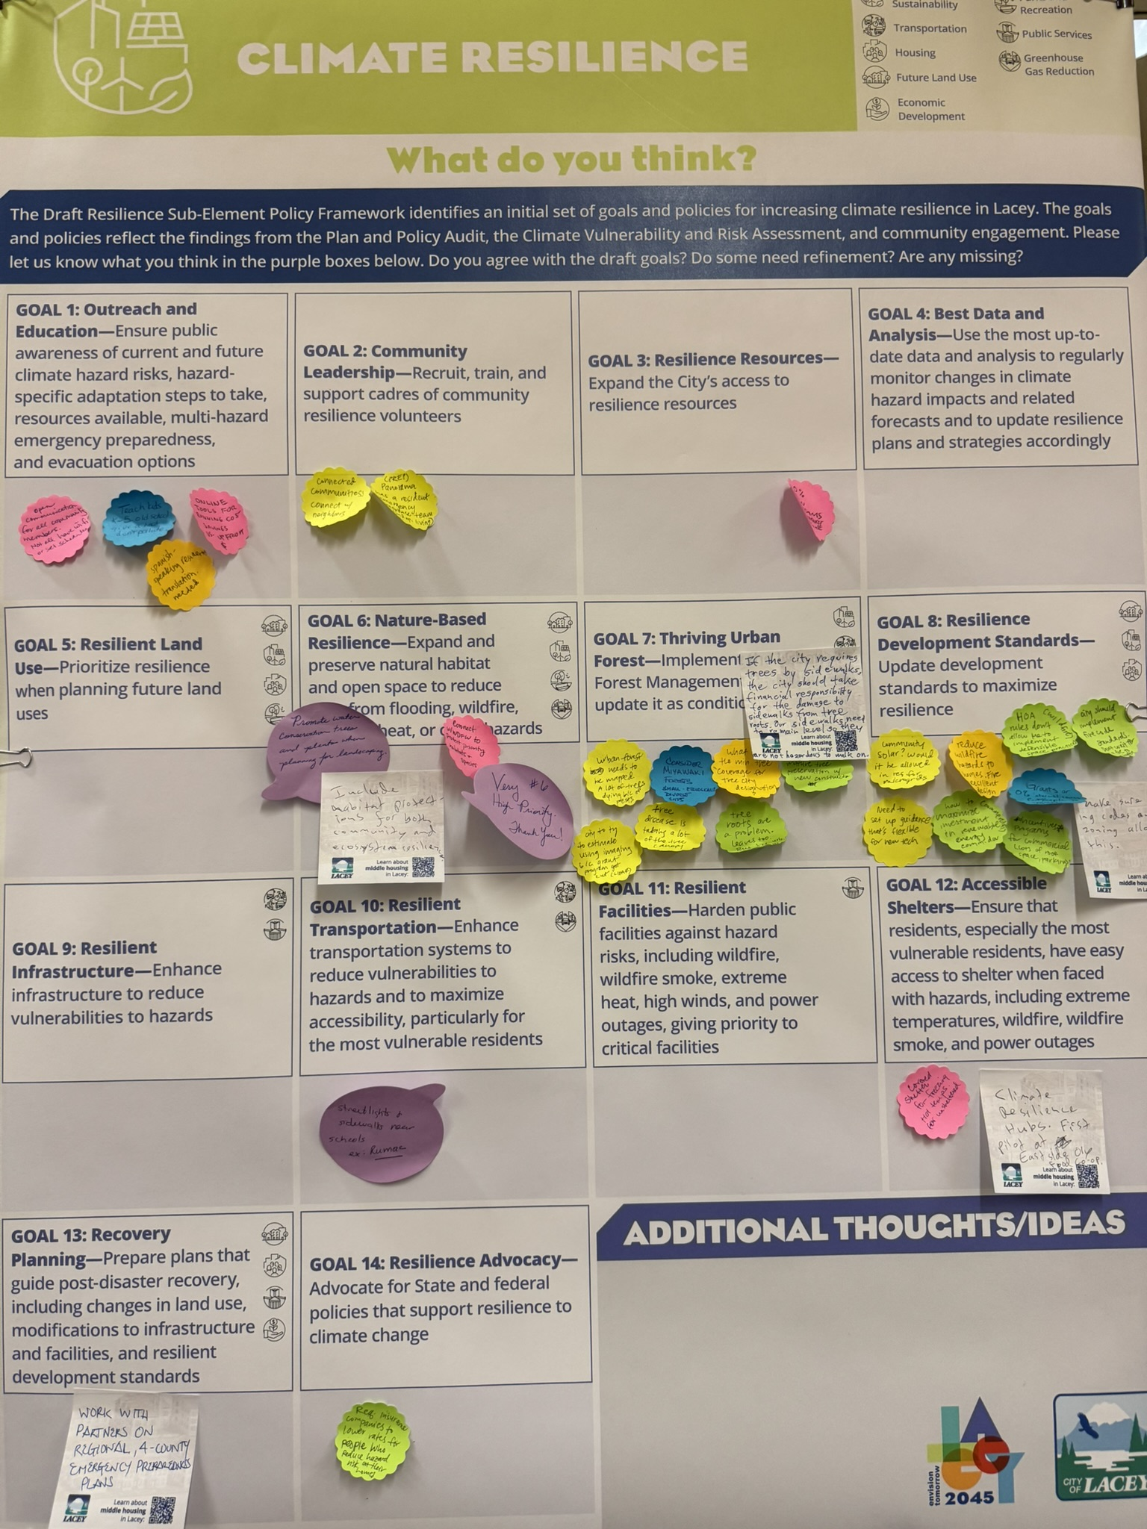
Comprehensive Plan Update
Community Input
Lacey community members attended our February open house.
Lacey staff attended a community information session hosted by TCAT.
Some comments we heard:
“We want to maintain tree city USA status”.
“EV revolution”.
“Ways to participate in solar power outside of panels on your roof”.
“How is equity considered in these plans”?

Slide 7
Questions?
Linsey Fields
Climate and Sustainability Coordinator
Linsey.fields@cityoflacey.org

