Slide 1
Climate Element
April 9, 2025 Update for Planning Commission
Notes:
Ron
Thank you, Ryan, Hans, and Linsey. Good evening commissioners.
My name is Ron Whitmore, and I’m a Principal with Raimi + Associates. Raimi + Associates is working with City staff and the Climate Team to prepare the Resilience Sub-Element.
I’ve been working in community sustainability for over 30 years across all sectors, including 13 years as a long-range planner and sustainability director in local government. For Raimi + Associates, I manage a mix of comprehensive plan updates and climate planning.

Slide 2
Background
Comprehensive plans are the centerpiece of local planning efforts. These 20-year plans articulate a community vision through a series of goals, objectives, policies, and actions that guide the day-to-day decisions of elected officials and local government staff.
Lacey's Goals for the 2025 Update
Readable and useable
Reflects the vision
Integrates and relatable between elements
Streamlined
Meets the GMA requirements and new laws

Slide 3
Background
Technical Analysis
Community Engagement
Goals and Policies are created through various avenues, including conducting audits on current plans, implementing new mandates and requirements, utilizing resources through the Department of Commerce, researching other cities plans, and aligning goals and policies with the community vision.
Goals are the overarching objectives a city intends to meet in the next GMA cycle. Policies are how we are going to meet those goals.
Goals & Policies
Comp. Plan Element
Notes:
For instance, Goal 5 of the GHG Subelement is to “Reduce Vehicle Miles Traveled”; how the city plans to meet that goals is laid out in the corresponding policies. Goals and policies are not overly prescriptive by nature so that it leaves room for the city to advance policies and programs flexibility.

Slide 4
Background
The climate element is a new requirement for this cycle of Comprehensive Planning for jurisdictions who fall into the Growth Management Act. Per HB 1181 "Cities and counties planning under the Growth Management Act must have a climate element as part of their comprehensive plan."
The Climate Element is made up of two sub-elements:
Greenhouse Gas Sub-Element (Mitigation Strategies).
Resiliency Sub-Element (Adaption Strategies).
Notes:
For instance, Goal 5 of the GHG Subelement is to “Reduce Vehicle Miles Traveled”; how the city plans to meet that goals is laid out in the corresponding policies. Goals and policies are not overly prescriptive by nature so that it leaves room for the city to advance policies and programs flexibility.

Slide 5
Background
Technical Analysis
Community Engagement
Technical Analysis Included:
Vulnerability and Risk Assessment for Climate Hazards
2022 Thurston County GHG Inventory
Policy Audits of current plans
Reviewing Commerce's guidance to ensure compliance.
Key Community Engagement Thems Included:
“20-minute towns with dense housing to make it easy for walking & bicycling to get most things needed without a car.”
“I want Lacey to be the cutest and most walkable, cycle-able, and accessible Tree City in Washington! My dream version of Lacey has separated bike lanes and sidewalks along all roads/streets.”
“A vibrant city center with small local businesses thriving, with pedestrians walking, cafes, local shops, restaurants, etc.”

Slide 6
Resilience Sub-element Policy Framework

Slide 7
Overview
Technical Analysis
Community Engagement
The Policy Framework outlines draft goals and policies of the Resilience Sub-Element
Adapts existing goals and policies from City plans
Recommends new goals and policies based on technical analysis and State Department of Commerce guidance
Incorporates input from the community and City staff
Policy Framework
Resilience Sub-Element

Slide 8
Requirements and Guidance
Hazards: Resilience Sub-Element must address climate-exacerbated hazards relevant to Lacey
Sectors: Commerce encourages jurisdictions to address climate vulnerability across 11 asset sectors
Co-Benefits: Commerce directs jurisdictions to note every co-benefit associated with each policy. Commerce provided a list of 13 co-benefit options.
Notes:
From HB 1181 and articulated in the Commerce guidance document

Slide 9
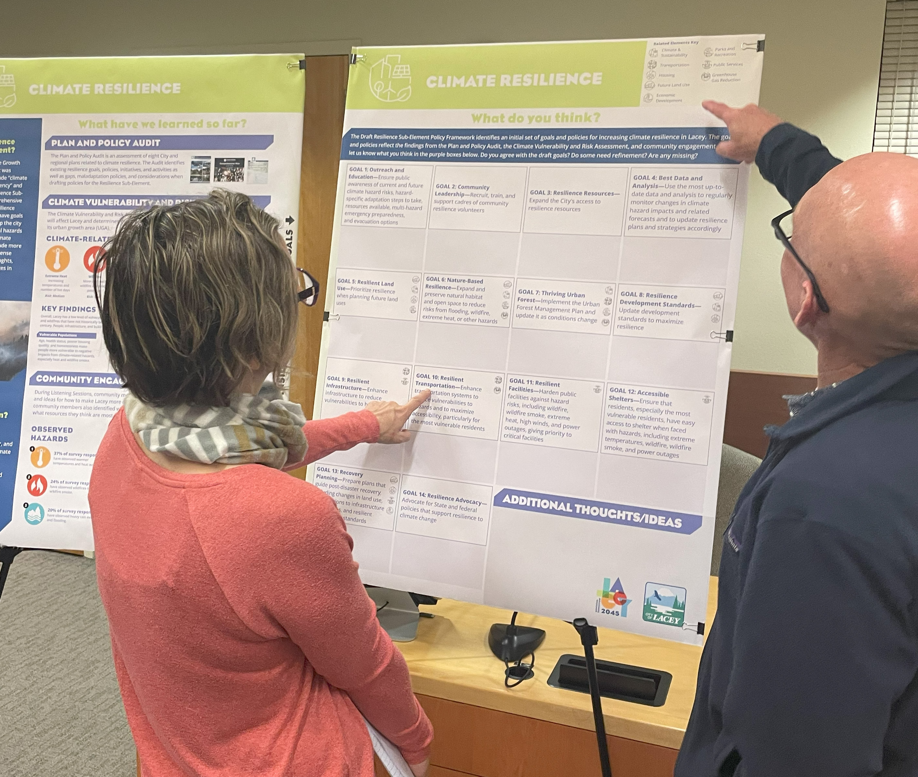
Open House Community Input
39 comments received
Goal 7: Thriving Urban Forest
Tree preservation
Diseases/pests
Trade-offs
Goal 8: Resilience Development Standards
Standards to reduce wildfire risk
Support solar

Slide 10
Second Administrative Draft
Incorporated Open House input
Integrated model goals and policies from Commerce’s Climate Policy Explorer
Consolidated goals (14 reduced to 12 goals)

Slide 11
Policy Framework Goals
Goal 1: Outreach and Education
Goal 2: Community Leadership
Goal 3: Resilience Resources
Goal 4: Up-to-date Data, Analysis, and Planning
Goal 5: Resilient Land Use
Goal 6: Nature-Based Resilience
Goal 7: Thriving Urban Forest
Goal 8: Resilience Development Standards
Goal 9: Resilient Infrastructure
Goal 10: Resilient Transportation
Goal 11: Resilient Facilities
Goal 12: Accessible Shelters
Notes:
We have provided the full framework document that has the goals and policies in your packet
Next, I’ll walk through some that we think are most important to discuss with you all today

Slide 12
Goal 5: Resilient Land Use
Prioritize Resilience when planning future land uses
Implement the Shoreline Master Program
Ensure development complements natural shoreline processes
Prioritize denser infill development over greenfield development to avoid encroachment on potential hazard areas
Avoid new or intensified development in hazard-prone areas
Limit development on or acquire areas to be natural hazard buffers
Notes:
Connection to LU element
Bring up that the state is making new wildfire maps which will be important for future land use.

Slide 13
Goal 7: Thriving Urban Forest
Expand and maintain the urban tree canopy/forest to maximize resilience to heat, drought, wildfire, and other hazards
Implement the Urban Forest Management Plan
Manage forests to be better adapted to climate change and pests
Maintain the “Tree City” status
Update City code to preserve trees during development and to mitigate impacts of tree roots on sidewalks
Notes:
Added more policies to this goal based on public input

Slide 14
Goal 8: Resilient Development Standards
Update development standards to ensure the resilience of development and redevelopment projects
Adopt fire wise standards that supersede HOA standards
Adopt resilience stormwater management standards such as green infrastructure and LID practices
Promote sustainable building design and landscaping
Identify financing options to help low-income residents
Advocate for lower insurance rates for property owners who reduce hazard risks
Notes:
Added the last two about financing and insurance based on public comments
Some connection to the Climate sub-element

Slide 15
Goal 12: Accessible Shelters
Ensure that residents, especially the most vulnerable residents, have easy access to shelter when faced with hazards, including extreme temperatures, wildfire, wildfire smoke, and power outages
Identify and advertise public facilities to serve as “resilience hubs”
Identify and publicize private facilities (like shopping centers) that have backup power and are willing to provide respite during hazard events
Notes:
Some participants at the open house expressed that this was important for equity reasons

Slide 16
Discussion Questions

Slide 17
Discussion Questions
What do you see as the most important goals and policies?
Is anything missing? Are there any additional goals or policies you think should be added?
What concerns do you have about any goals and policies?
Do you disagree with any policy direction?
Are any goals or policies unclear?
Should any be softened or strengthened?

Slide 18
Greenhouse Gas Sub-element Goals and Policies

Slide 19
Requirements and Guidance
GHG Emissions Reduction: This Sub-Element must address GHG emissions and steps to reduce GHG in our community.
Vehicle Miles Traveled: The GHG sub-element must address VMT and steps to reduce VMT in our community.
Co-Benefits: Commerce directs jurisdictions to note every co-benefit associated with each policy. Commerce provided a list of 13 co-benefit options.
Notes:
From HB 1181 and articulated in the Commerce guidance document

Slide 20
Policy Framework Goals
Goal 1: Implement the Thurston Climate Mitigation Plan
Goal 2: Reduce GHG emissions by incentivizing the use of renewable energy, conservation, and efficiency technologies and practices in buildings.
Goal 3: Develop guidelines for the adaptive reuse of buildings.

Slide 21
Policy Framework Goals
Goal 4: Increase tree canopy cover to boost carbon sequestration, while increasing solar access, where practicable.
Goal 5: Reduce vehicle miles traveled.
Goal 6: Support increased urban density and housing diversity
Goal 7:The City of Lacey (as an organization) will strive to reduce Greenhouse Gas Emissions to 45% below 2022 levels by 2035; reduce to 75% below 2022 levels by 2040 and achieve Net-Zero by 2050.

Slide 22
Goal 1: Implement the Thurston Climate Mitigation Plan
Policy 1. A: Explore local funding sources for the Thurston Climate Mitigation Plan strategies and actions.
Policy 1. B: Partner with and support the Thurston Climate Mitigation Collaborative's climate work.

Slide 23
Goal 5: Reduce Vehicle Miles Traveled
Policy 5. C : Implement multimodal transportation planning to reduce single-occupancy vehicle dependence and greenhouse gas emissions.
Policy 5. D: Implement a safe, well-connected, and attractive bicycle and pedestrian transportation network through prioritizing projects in the Lacey Pedestrian and Bicycle Plan

Slide 24
Goal 7: GHG Emissions Reduction
Goal: The City of Lacey will strive to reduce Greenhouse Gas Emissions to 45% below 2022 levels by 2035; reduce to 75% below 2022 levels by 2040 and achieve Net-Zero by 2050.
Policy 7. A: Retrofit city-owned buildings for energy efficiency and conduct energy audits on city facilities.
Policy 7. B: Transition public fleets to zero-emission vehicles and develop supporting infrastructure and programs.

Slide 25
Discussion Questions

Slide 26
Discussion Questions
What do you see as the most important goals and policies?
Is anything missing? Are there any additional goals or policies you think should be added?
What concerns do you have about any goals and policies?
Do you disagree with any policy direction?
Are any goals or policies unclear?
Should any be softened or strengthened?

Slide 27
Next Steps
CED Staff will present to the council on April 15th.
Council and Commissions review will be incorporated into final draft versions.
The Climate Element will be packaged into the larger Comprehensive Plan for community review this summer.
We are here

