Slide 1
Comprehensive Plan Update Transportation Element
Steven Goodsell, Dan Grayuski | Fehr & Peers

Slide 2
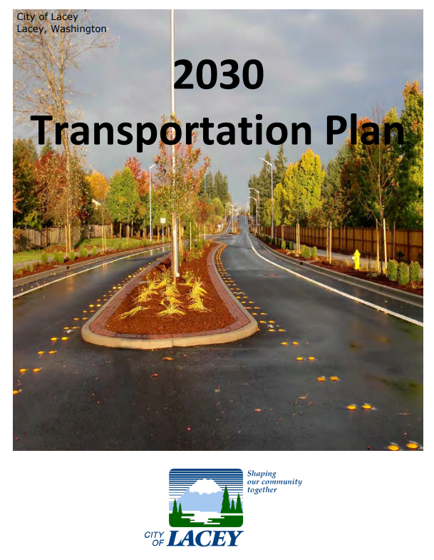
The Transportation Element
Requirements
Transportation Themes
Previous Transportation Plans
Your Feedback
Our Status
City of Lacey Transportation Plan, 2012

Slide 3
Transportation Elements
Land use assumptions
State-owned transportation facility analysis
Funding analysis
Intergovernmental coordination efforts
Demand management strategies
Multimodal transportation analysis
Facility and service needs
Community engagement
ADA Transition Plan

Slide 4
New Growth Management Act (GMA) Requirements HB 1181: Climate Response and Comprehensive Planning HB 1110: Missing Middle Housing HB 1337: Accessory Dwelling

Slide 5
HB 1181: Active Transportation
The term “pedestrian and bicycle facilities” is being replaced by “active transportation facilities”
Defined as “facilities provided for the safety and mobility of active transportation users including, but not limited to, trails, as defined in RCW 47.30.005, sidewalks, bike lanes, shared-use paths, and other facilities in the public right-of-way.” (p. 39)
Active transportation facilities should be included in existing conditions reporting.

Slide 6
HB 1181: Multimodal Planning & Level of Service
Multimodal Level of Service (MMLOS) in place of vehicular Level of Service (LOS)
MMLOS impacts to replace general “traffic impacts”
Facilities that provide the greatest safety benefit to each category of roadway users should be prioritized.
Development cannot be denied for LOS failure/concurrency reasons if impacts can be mitigated through active mode, transit, ride sharing, demand management, or other transportation management strategies funded by the development.

Slide 7
HB 1181: Climate-Related Metrics
Requires greenhouse gas (GHG) emission & vehicle miles traveled (VMT) reducing policies
https://wsdot.wa.gov/sites/default/files/2023-01/2023-state-of-transportation.pdf

Slide 8
HB 1181: ADA Transition Planning
Perform self-evaluations of current facilities in relation to ADA requirements
Develop program access plans or “transition plans” to:
Identify physical obstacles
Develop a schedule for making changes

Slide 9
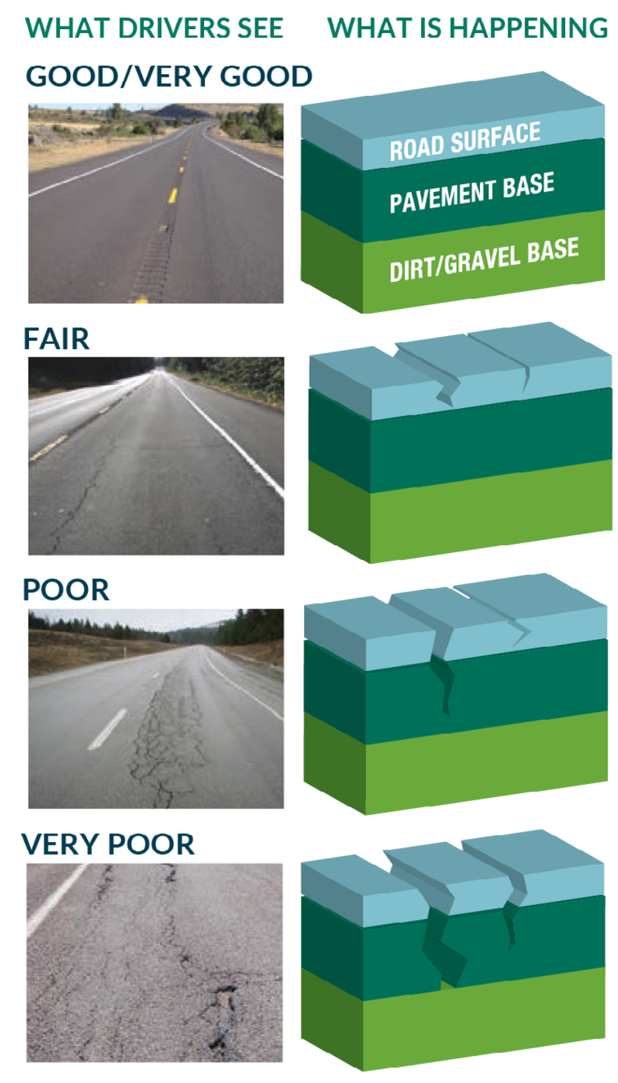
HB 1181: State Facilities Funding
Must include a discussion of how funds will be raised to address identified needs of the transportation system, including state-owned facilities.
https://wsdot.wa.gov/sites/default/files/2021-10/Washington-State-DOT-Transportation-Asset-Management-Plan.pdf

Slide 10
HB 1110 & HB 1337: Housing
3 future land use alternatives will be considered –
Affects of future land uses on the transportation system will be analyzed using TRPC’s travel demand model.

Slide 11
Checklist Requirements

Slide 12
Commerce Transportation Element Checklist
Existing conditions inventory
Multimodal level of service (MMLOS) standards
Mitigations
Future year forecast based on land use assumptions
State and local system needs to equitably meet current and future demand
https://www.commerce.wa.gov/growth-management/gma-topics/periodic-update/

Slide 13
Commerce Transportation Element Checklist - Continued
ADA Transition Plan
An active transportation component
Transportation Demand Management (TDM)
Future funding analysis
Multi-year financing plan based on needs identified in the comprehensive plan
https://www.commerce.wa.gov/growth-management/gma-topics/periodic-update/

Slide 14
Commerce Transportation Element Checklist - Continued
Discussion of how additional funds will be raised, or how land use assumptions will be reassessed to ensure that LOS standards will be met
Including state facilities – WSDOT to set requirements
Description of intergovernmental coordination efforts
Consistency with the Regional Transportation Plan (RTP)
https://www.commerce.wa.gov/growth-management/gma-topics/periodic-update/

Slide 15
TRPC Checklist
Almost identical to the Commerce checklist
Additional checklist item:
“The transportation element demonstrates how the town/city/county is making system investments to reduce the number of traffic fatalities and serious injuries on its roadways.” (RTP Policy 4.i)

Slide 16
Transportation Themes

Slide 17
Transportation Themes
Safety – The Safety System Approach
Multimodal Considerations & MMLOS
Congestion (Operations)
Complete Streets
State of Good Repair
Sustainability & Equity

Slide 18
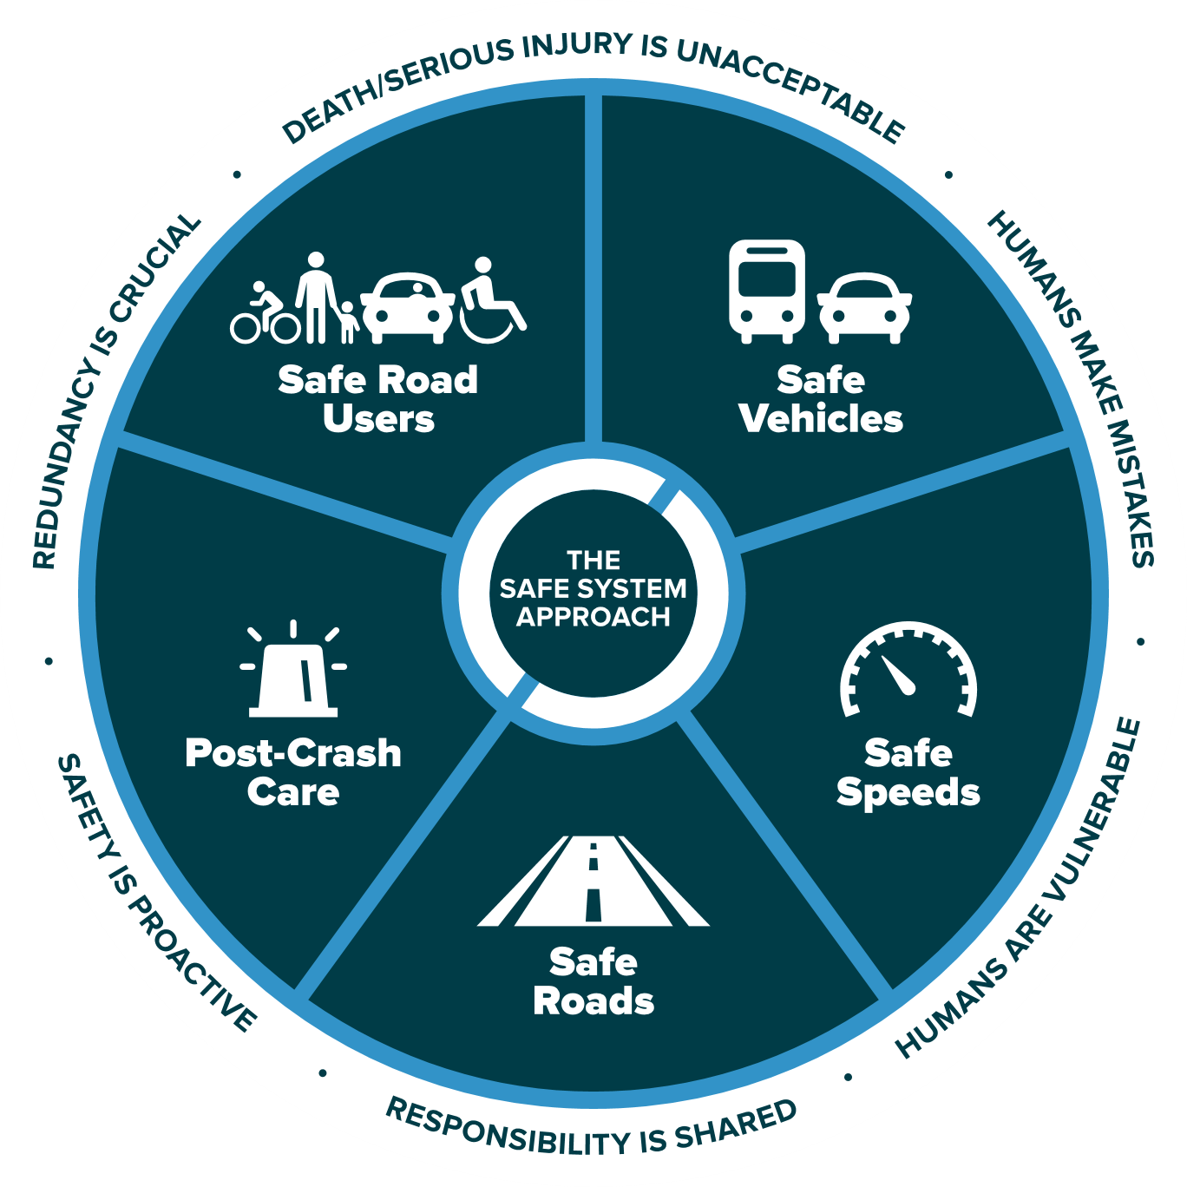
The Safe System Approach
Source: FHWA

Slide 19
Multimodal Transportation & MMLOS
Auto
Pedestrian
Bicycle
Transit

Slide 20
MMLOS – The Menu is Large
AUTO
PEDESTRIAN
BICYCLE
TRANSIT
GLOBAL
Intersection delay
V/C ratio
Corridor travel time
Sidewalks
Connectivity
Block length
Perceptions of safety/stress
Network completeness
Connectivity
Perceptions of safety/stress
Service present
Service quality
Corridor amenities
Mode split
VMT
Person trips
Person delay
Mobility units

Slide 21
Level of Traffic Stress
Source: Pierce County Transportation Element

Slide 22
Congestion
Building our way out of congestion?
Capacity projects are useful but expensive.
Increased vehicle capacity can adversely affect safety.
Can the system operate more efficiently?

Slide 23
Resilient Responses to Congestion
Safety Improvements
ITS & Targeted Vehicle Capacity
Multimodal Expansion
Public Transportation
Active Transportation

Slide 24
Complete Streets
https://highways.dot.gov/complete-streets/complete-streets-fhwa

Slide 25
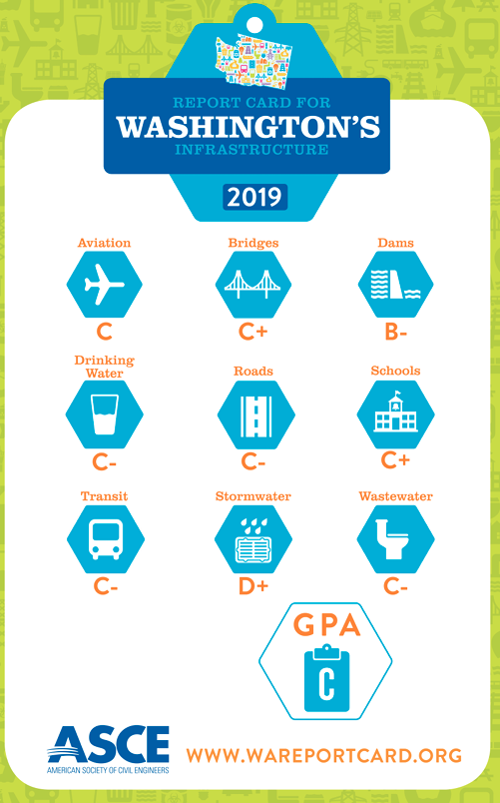
State of Good Repair
Return on investment - preservation

Slide 26
Sustainability
Natural Disasters
Cybersecurity Threats
Climate Impacts
Equity
Economy

Slide 27
Previous Plans

Slide 28
2030 Transportation Plan
2012 conditions
2030 forecasts
Multimodal vision
“Evaluating all transportation modes enables the City to address its future needs in a comprehensive manner, and supports the goal of reducing dependency on single occupancy driving.”
City of Lacey Transportation Plan, 2012

Slide 29
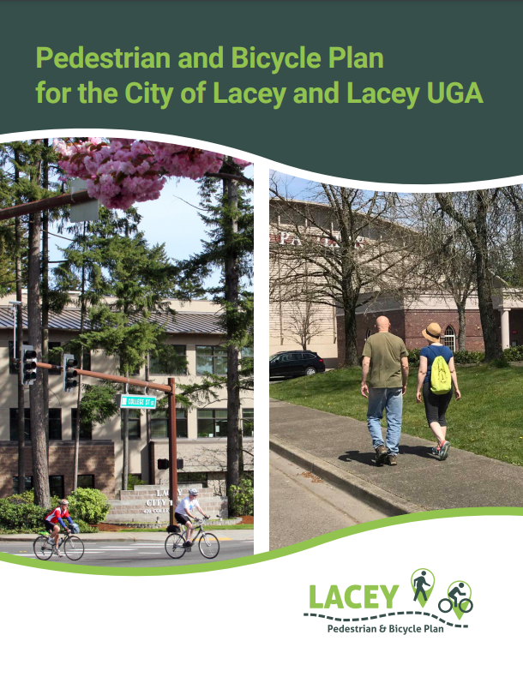
2018 Pedestrian and Bicycle Plan
3 Guiding Principles
Make it safe
Make it connected
Build momentum
Identified and prioritized projects
Pedestrian and Bicycle Plan, 2018

Slide 30
Feedback Status

Slide 31
Feedback
Based on the transportation themes, previous plans, and “Envision Tomorrow” –
What themes would you like emphasized in the Transportation Element?

Slide 32
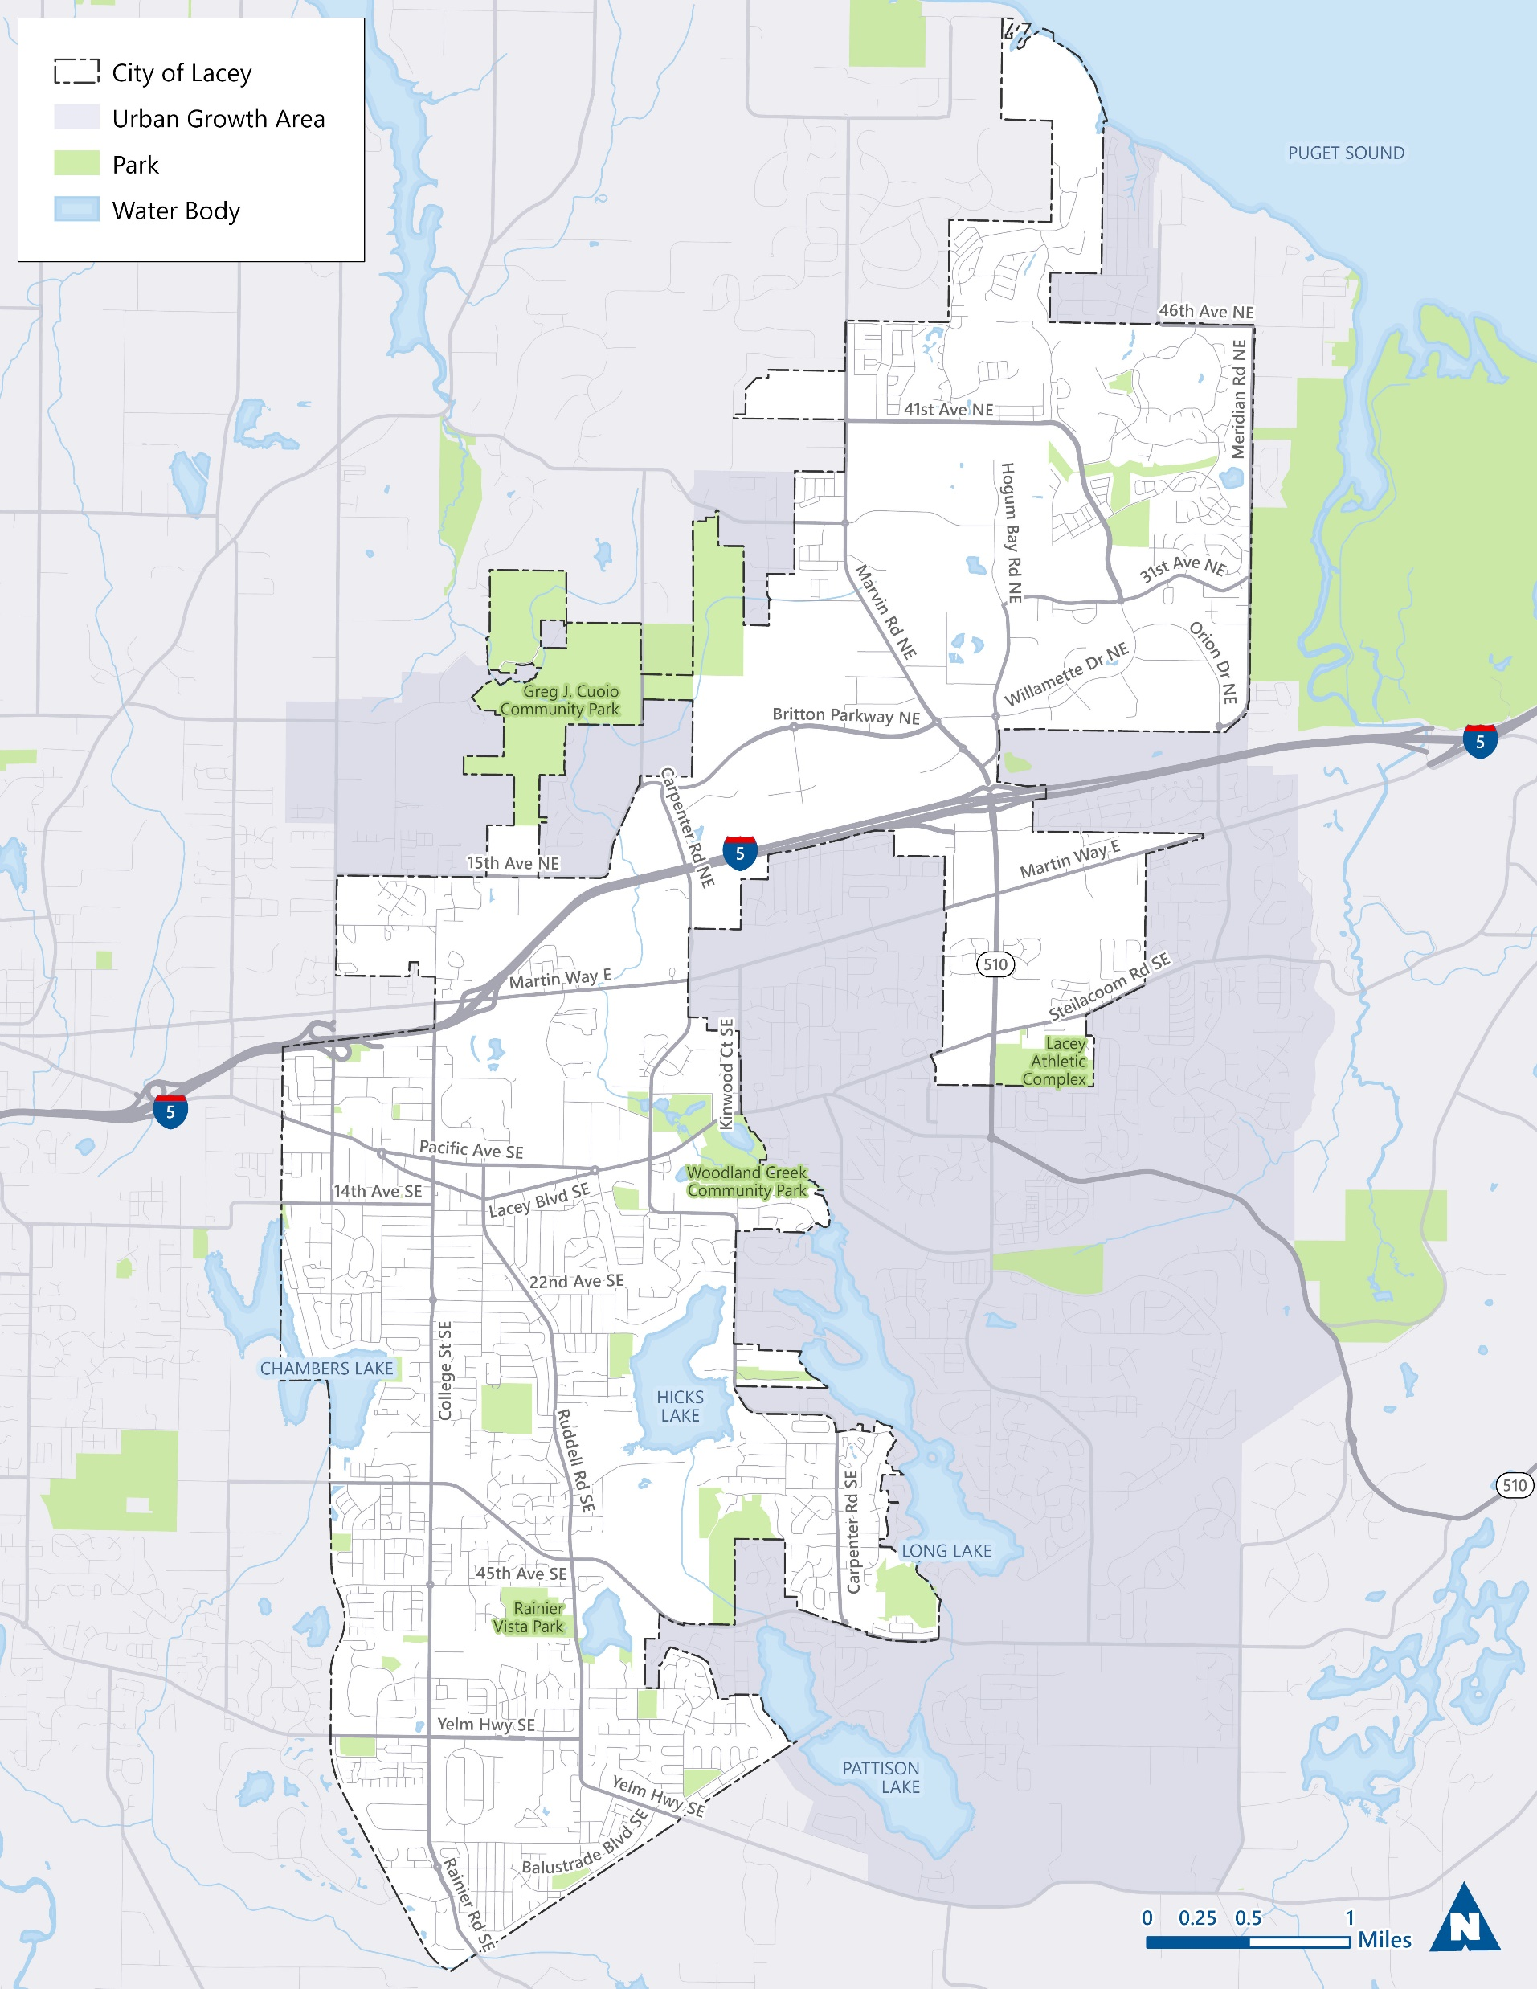
Our Status
Existing conditions
TRPC coordination
Preliminary projects list
Incorporating new requirements

Slide 33
