Slide 1
Lacey Comprehensive Plan
Outreach & Engagement Update
-
Council Worksession
September 10th, 2024

Slide 2
Communications & Community Engagement
Goal: To ensure an inclusive, informative update to the Comprehensive Plan, fostering active community participation and a sense of ownership in the final product.

Slide 3
Communications Section
Identifies strategies that:
Ensure consistent messaging
Increase familiarity with the comprehensive planning process
Encourage broad community buy-in

Slide 4
Community Engagement Section
Identifies strategies to:
Boost general community participation
Include community groups that are typically underrepresented in the planning process
communities of color, low-income households, non- or limited-English-speaking, youth and young adults, renters, military personnel

Slide 5
Community Engagement Phasing
Visioning
(Summer/Fall 2024)
Community
Priorities
(Winter 2024/25)
Draft Plan
(Spring 2025)
Final Plan
(Summer 2025)
Multiple opportunities for public engagement throughout the update process…

Slide 6
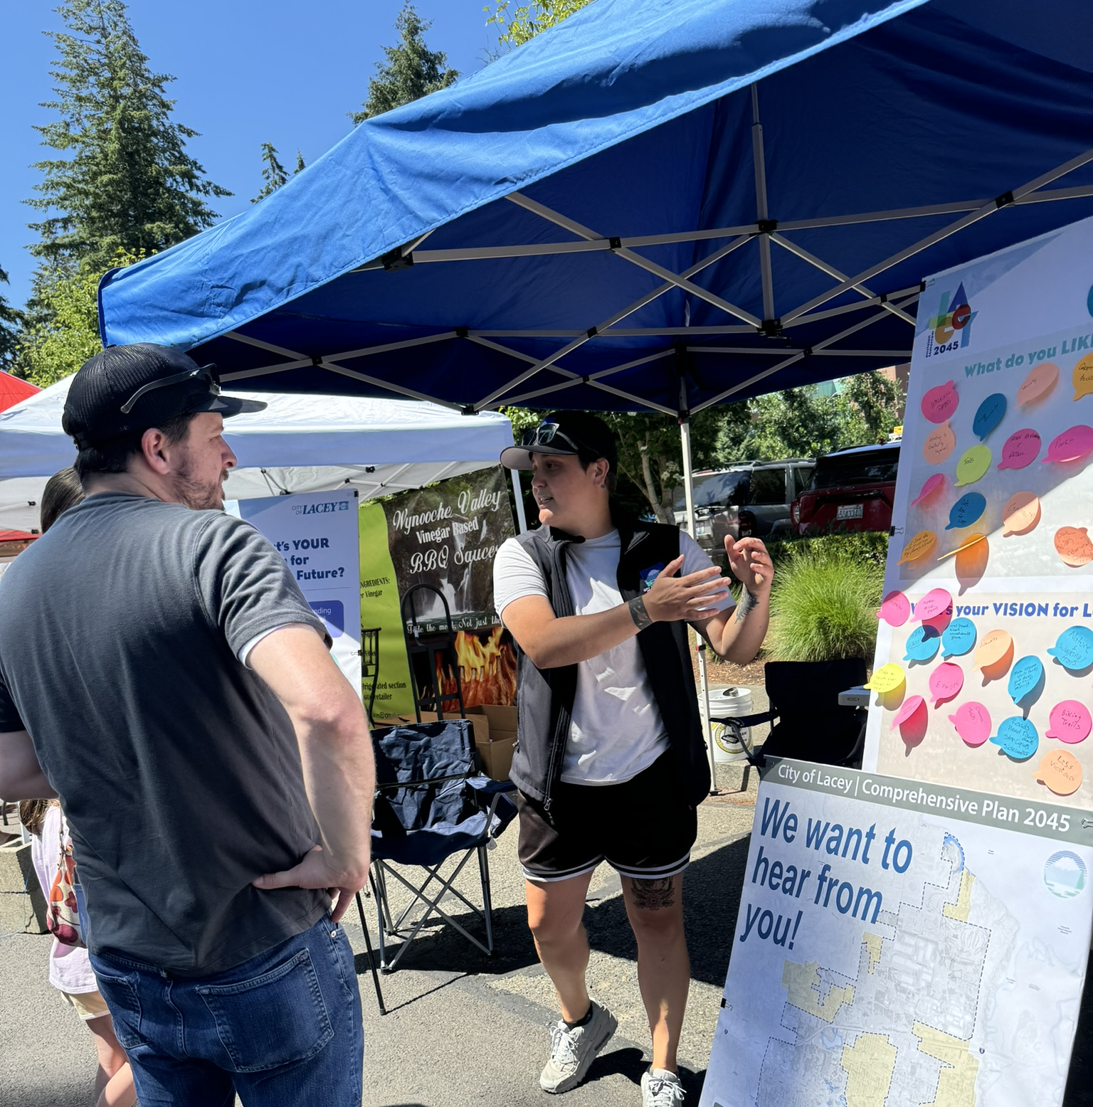
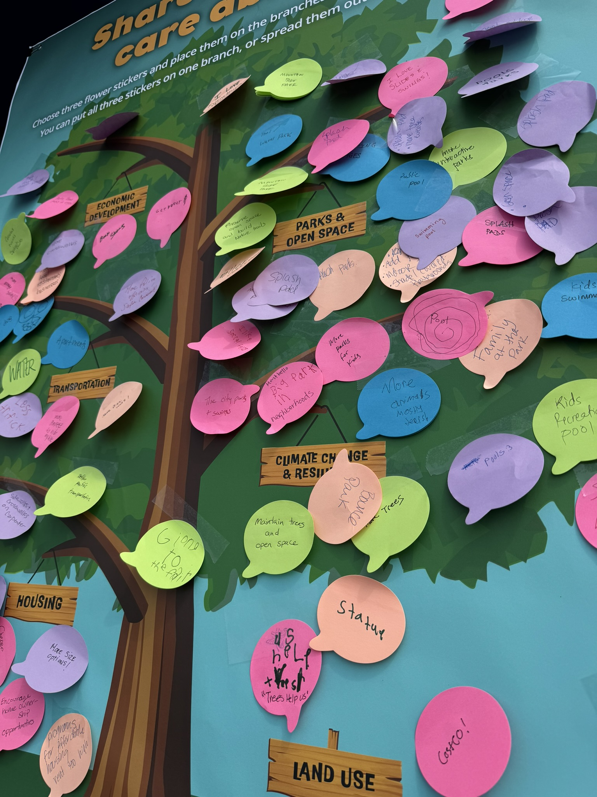
Phase 1: Visioning
Visioning Workshops
City Council
Youth Council
Planning Commission
Table at local events
BBQ Fest & Cops Cars n Kids
Youth and family-friendly
Engaging interactive exercises
Launch Community Survey & Website
Promote via City website and social media

Slide 7
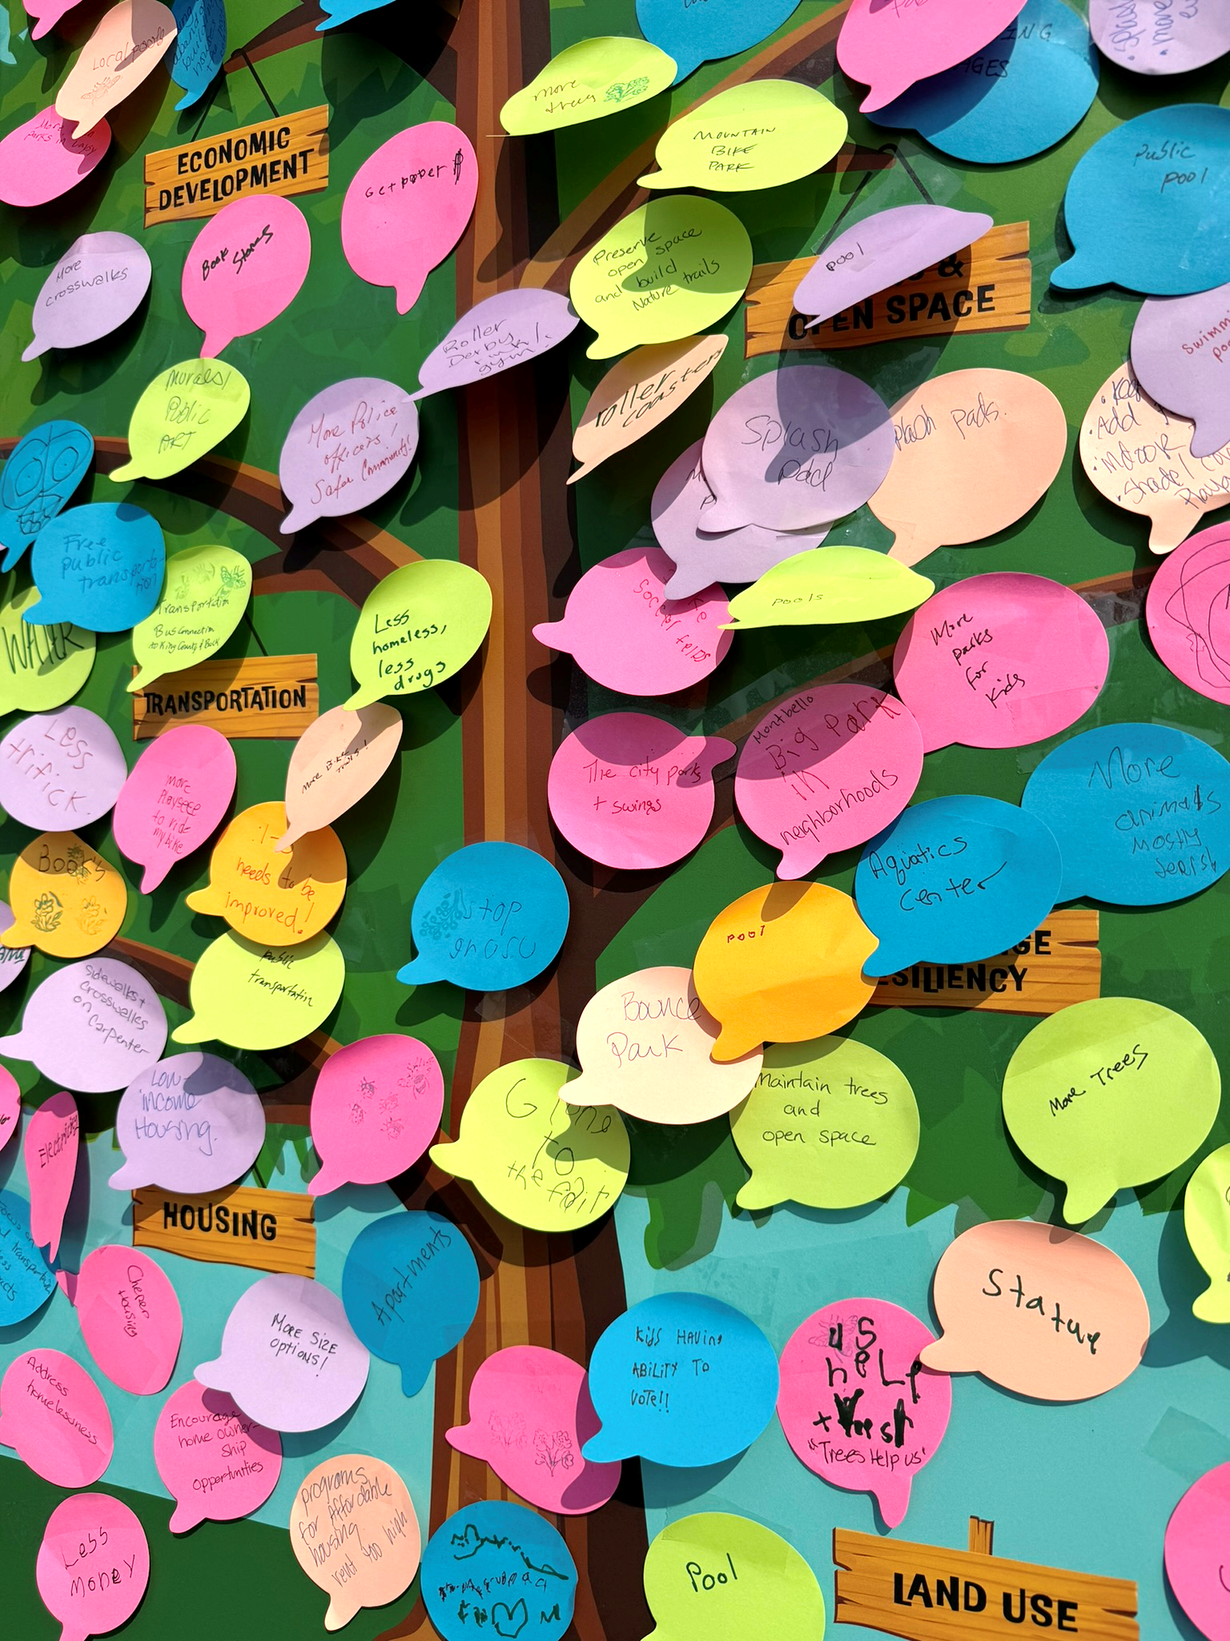
Early Feedback
BBQ Fest (68 Comments)
What's your VISION for Lacey's Future?
Sidewalks, crosswalks, bike lanes, accessible
Pool & splash/spray park
Affordable housing
Health care, hospitals, mental health
Cops Cars n Kids (111 Comments)
Share what you care about!
Increased connectivity (regional & local)
Interactive parks & splash pad
Trees & natural settings
Affordable home ownership & housing options

Slide 8
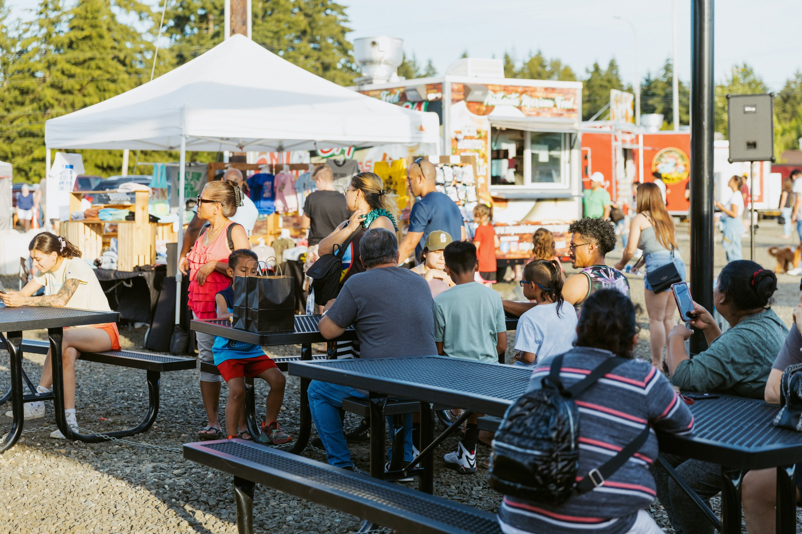
Upcoming Events
Children's Day
October 5th, 2024
Huntamer Park
Winter Fest
November 2nd, 2024
Lacey South Sound Chamber
Lacey Cultural Celebration
Spring 2025
Location/Date TBD

Slide 9
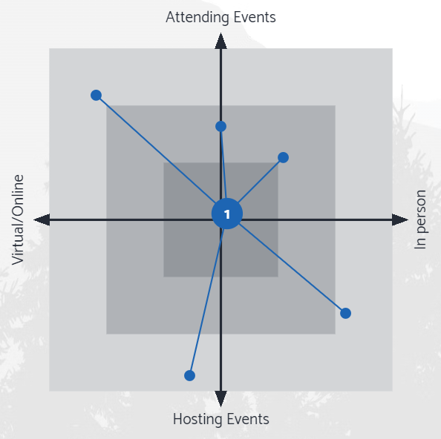
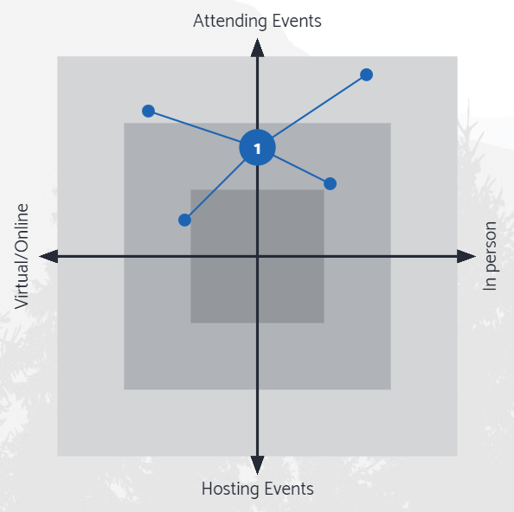
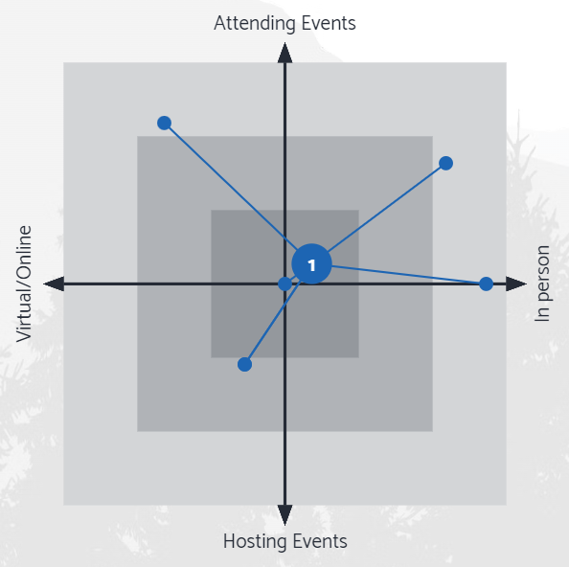
Direction from Visioning Sessions
Finding the right blend of outreach & engagement
CC
YC
PC

Slide 10
Phase 2: Community Priorities
Translating visions into draft policies
Launch map-based survey targeting local communities
Conduct outreach through community partners
Educational outreach through local schools
Local business outreach (lunch & learn, e.g.)

Slide 11
Phase 3: Draft Plan
Draft Plan Open House (in-person and virtual)
Spring & early summer 2025
Interactive/drop-in kiosks at Library/City Hall
Launch the web-based plan that allows for user comments on policy directions
Continue outreach to community partners, schools, businesses, etc.

Slide 12
Phase 4: Final Plan
The final Comprehensive Plan will be a web-based document
Frames policies in an easy-to-understand way
Allowing users to access the level of detail they want
The final plan will include chapters in a printable format

Slide 13
Frequency of briefings moving into 2025
Staff Recommendation:
Maintain quarterly updates through Spring of 2025
Higher frequency of meetings moving into summer and fall 2025
Special 4:00 pm start times before regularly scheduled meetings
Topic specific worksessions (on as needed/monthly basis)
Visioning
(Summer/Fall 2024)
Community
Priorities
(Winter 2024/25)
Draft Plan
(Spring 2025)
Final Plan
(Summer 2025)

