Slide 1
Comprehensive Plan Outreach Results
City Council | February 4, 2025

Slide 2
Community Engagement

Slide 3
Outreach Overview
Timeline
July 2024 → December 2025
2024 In-Person Events
Visioning Sessions, South Sound BBQ, Cops, Cars, n Kids, Children's Day, Winter Fest, Depot Holiday Night Market
Survey Distribution
City Website, Social Media, News Articles, Lacey Life, CP Video, Utility Insert, HOA Distribution, NTSD, Youth Council, Commission on Equity, Veterans Services, St. Martin’s, Planning Counter, Multifamily Properties, Business Community, Library
Incentive: Five $100 gift cards to qualifying survey participants
Total Outreach (to date): Approx. 45,000 Direct Community Contacts

Slide 4
In-Person Engagement
South Sound BBQ, Cops Cars n Kids, Children's Day, Winter Fest, Depot Holiday Night Market, 2025 Cultural Celebration
282 written comments – “what do you care about?”
Common Themes
Increased connectivity (sidewalks, crosswalks, bike lanes, accessibility)
Year round recreation (covered/indoor, turf/lights, pool/splash park)
Affordable home ownership, housing options, higher densities
Trees, natural settings, community gardens, environmental protections

Slide 5
Online Engagement
Social Media Reach (as of 1/14/2025)
Total posts: 23
Views/Reach: 10,193
Interactions (clicked link, shared, comments, likes, etc.): 622
Online Survey (concluded 01/05/2025)
397 survey participants
Languages: English, Spanish, Vietnamese
November Snapshot of Survey Activity

Slide 6
Additional Outreach Numbers
Email Distribution Lists
1,831 individual emails (Comp Plan, HOA, Lacey Life + Weekly Press Releases)
Utility Mailing
24,757 inserts to Lacey Residents
Business Outreach
32 interviews (Economic Development Coordinator)
1,964 Newsletter Contacts
Racially Disparate Impacts Analysis
Uncommon Bridges – Community Interviews (Affinity Groups—ADU, low income, manufactured home, military)
Video Survey in English and Spanish. $25 per participant.
Listening Sessions
Climate Change and Resiliency (Climate and Other Non-Profits, Real Estate)

Slide 7
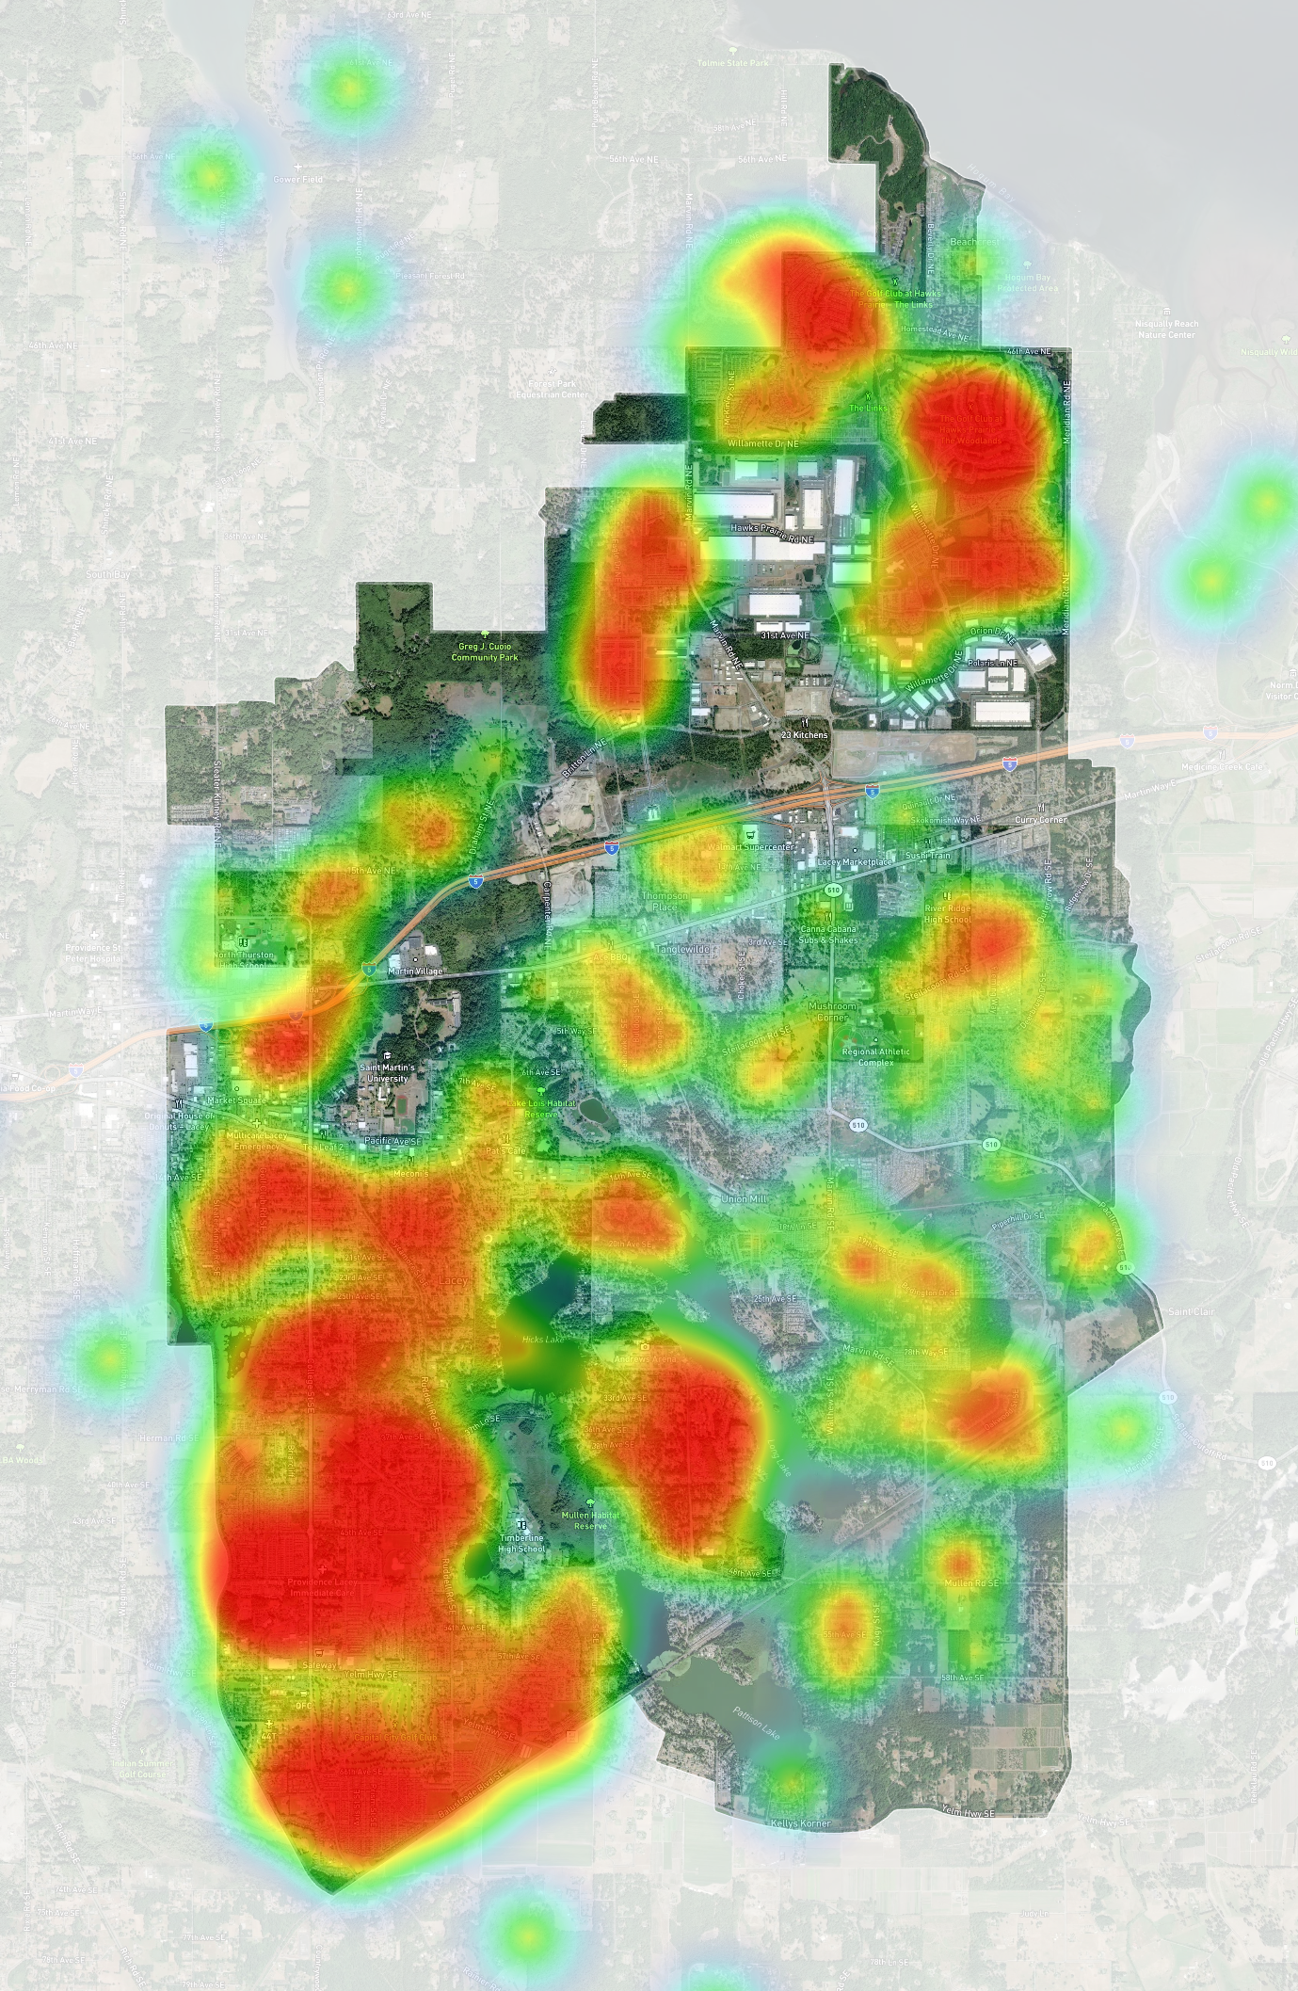
Who we heard from
Heatmap of survey respondent home locations
88.1% live in Lacey
29.8% work in Lacey
78.6% report travel to work time ≥ 15 minutes (‘24 ACS)
77.0% identified as white or Caucasian
7.2% Hispanic or Latinx, 6.8% Asian, 5.0% Black or African American
52.6% identified as female
Median age: 35 to 49
Median household income: $100-149K
63.9% have lived in Lacey for 5+ years
Results within a few percentage points of Lacey Community (Lacey + UGA)

Slide 8
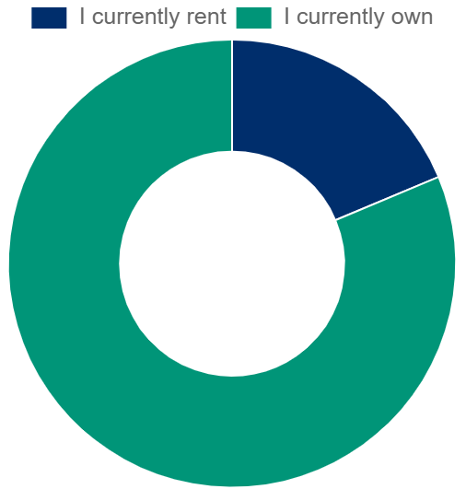
Targeted Outreach: Renters
Renter Occupied Housing within City and UGA: 34.3%
2024 ESRI - 38.6% within City*
Multifamily Site Visits
32 locations (3,992 units)
Email & Information Kiosks
Management Agency Distribution
Email distribution to tenants
Targeted Social Media Boosts
22.5% of respondents since Mid-November
9% increase in renter participation vs. pre targeted outreach
18.8%
2024 Survey
Results
81.2%

Slide 9
Community Guidance

Slide 10
Survey Questions
Vision for the Future of Lacey:
When thinking about the future of our city, what do you want it to look like?
Quality of Life (how our culture and values match with our goals, expectations, standards, and concerns):
In what ways can the City of Lacey support and improve upon our community's quality of life?

Slide 11
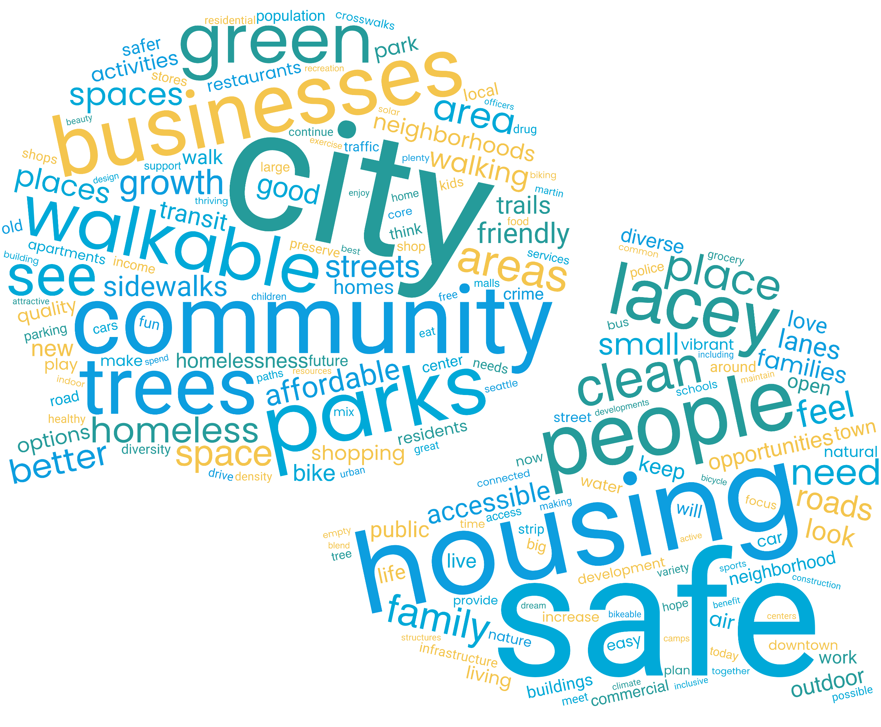
Community Goals
Transportation Infrastructure & Network Connectivity (walkability)
Public Health, Safety, and Social Services
Affordable Housing & Urban Development
Sustainability & Environmental Conservation
Community Identity, Amenities & Recreation
Economic Growth & Local Businesses
*Categories are based on frequency and staff understanding of comments.

Slide 12
Community Goals
Transportation Infrastructure & Network Connectivity (walkability)
Better pedestrian and cyclist infrastructure – expanded networks and quality
Requests for accessible neighborhoods with walkable amenities
Concerns over sprawl and car dependent developments
Representative Comment(s):
“20-minute towns with dense housing to make it easy for walking & bicycling to get most things needed without a car.”
“I want Lacey to be the cutest and most walkable, cycle-able, and accessible Tree City in Washington! My dream version of Lacey has separated bike lanes and sidewalks along all roads/streets.”
“Better public transportation. Less reliance on cars, with improved transit options and more convenient bus services.”

Slide 13
Community Goals
Public Health, Safety, and Social Services
Proposals for structured solutions, such as shelters and rehabilitation programs
Requests for additional, law enforcement, mental health, and emergency services
Comments frequently identified concerns over housing, mental health, and crime
Representative Comment(s):
“A diverse, safe community that cares for each other and our environment. One that is clean, safe, and welcoming to everyone."
“We need a proper solution for homelessness—something that stops people from becoming homeless in the first place.”
“Provide 24/7 mental health services for emergency attention.”

Slide 14
Community Goals
Affordable Housing & Urban Development
Opposition to overdevelopment that detracts from the community's character ("cookie-cutter" developments)
Need for affordable housing, mixed-income neighborhoods, and modular housing solutions
Requests for cohesive, beautiful, eco-friendly, treed developments
Representative Comment(s):
“… affordable ownership of homes in multi-story construction projects with great walkability…”
“… Where development is mindful of going upward, not outward…”
“Bring businesses and homes more together so we're less car-dependent…”

Slide 15
Community Goals
Sustainability & Environmental Conservation
Emphasis on preserving trees, forests, and natural habitats
Focus on renewable energy, sustainable urban growth, eco-friendly practices, and projects that minimize environmental impacts
Advocating for eco-friendly initiatives like renewable energy and reduced reliance on fossil fuels.
Representative Comment(s):
“20-minute towns with dense housing to make it easy for walking & bicycling to get most things needed without a car.”
“Encourage people to shift away from manicured lawns to native plants and wildflowers. Promote organic gardening, re-wilding, and regenerative agricultural practices.”
“Stop cutting down the trees. Replant trees where they have already been relentlessly removed…”

Slide 16
Community Goals
Community Identity, Amenities & Recreation
Interest in creating parks, family-friendly spaces, and facilities like community centers, trails, and playgrounds
Calls for stronger community connections and local cultural events
Suggestions for creating a distinct identity for Lacey, separate from neighboring cities. More “downtown-style” gathering areas and community-centric spaces
Representative Comment(s):
“Activities indoor and outdoor for families and people from age 12-25.”
“We need more local playhouses, theaters, spaces for cultural and artistic events.”
“Encourage more neighborhood gathering places where residents meet and mix.”
“Continue to invest in beautification and improvement projects to keep our city competitive.”

Slide 17
Community Goals
Economic Growth & Local Businesses
Requests for revitalizing commercial areas to make them more attractive and functional
Calls for a sense of community, with spaces for gathering, social events, grocery stores, restaurants, and cultural programming
Supporting small businesses: providing assistance, lowering taxes for entrepreneurs, encouraging local investments
Representative Comment(s):
“A vibrant city center with small local businesses thriving, with pedestrians walking, cafes, local shops, restaurants, etc.”
“It is hard to say, but we do not really have a 'downtown.' What is the plan for the 'mall’?”
“Keep the focus small and inward…Invest meaningfully in small/micro businesses.”

Slide 18
Survey Geobudgeting

Slide 19
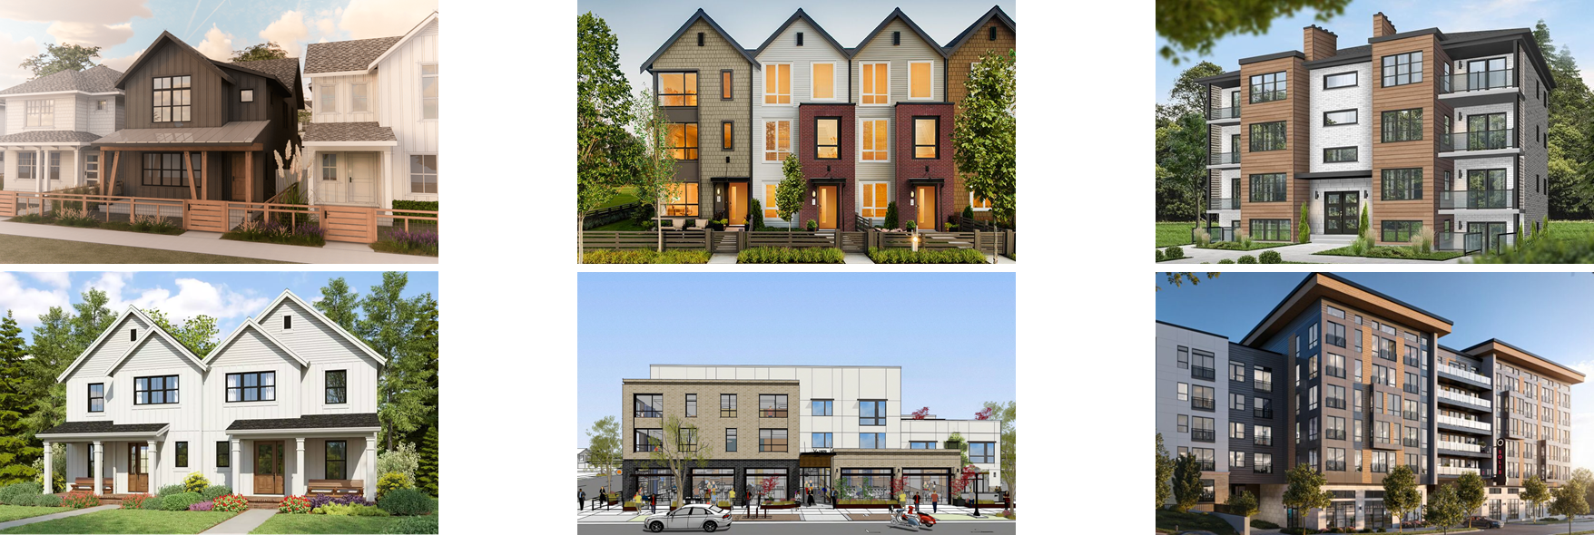
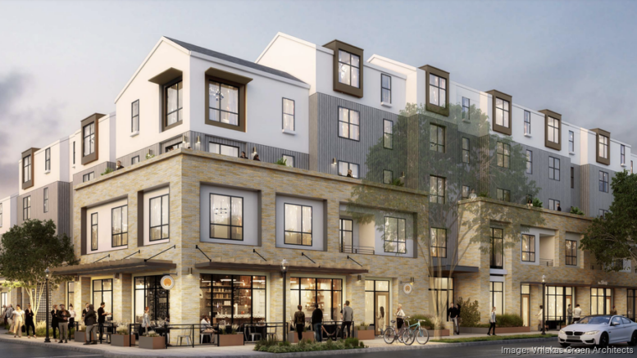
Geobudgeting: Residential
Where will new homes go?
Current projections show 20,000 more people moving to the area over the next 20 years. With this in mind, Lacey must find space for approximately 8,250 new homes.
Detached Homes
Townhomes
Small Multifamily
Duplex / Triplex
Mixed Use
Larger Multifamily

Slide 20
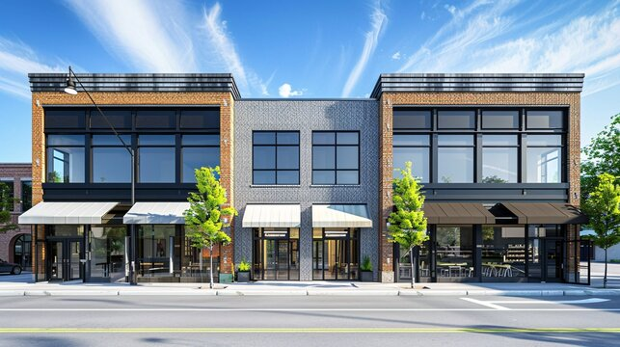
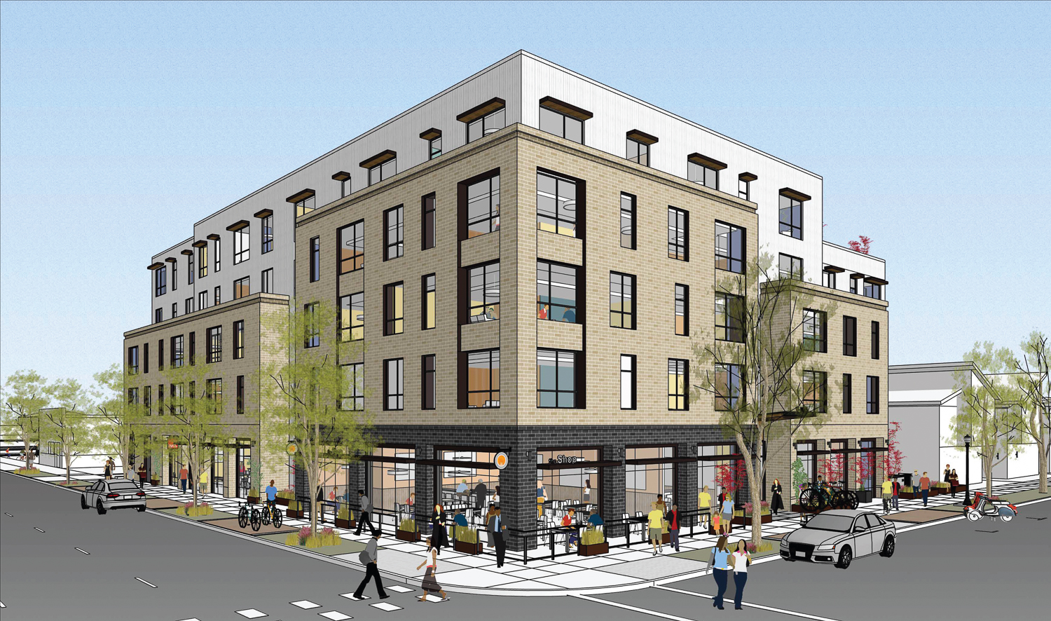
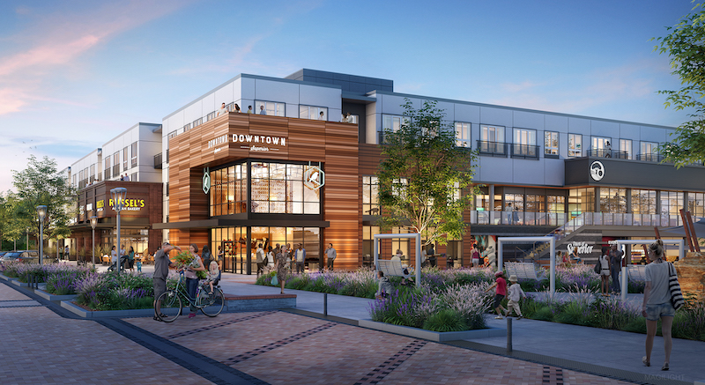
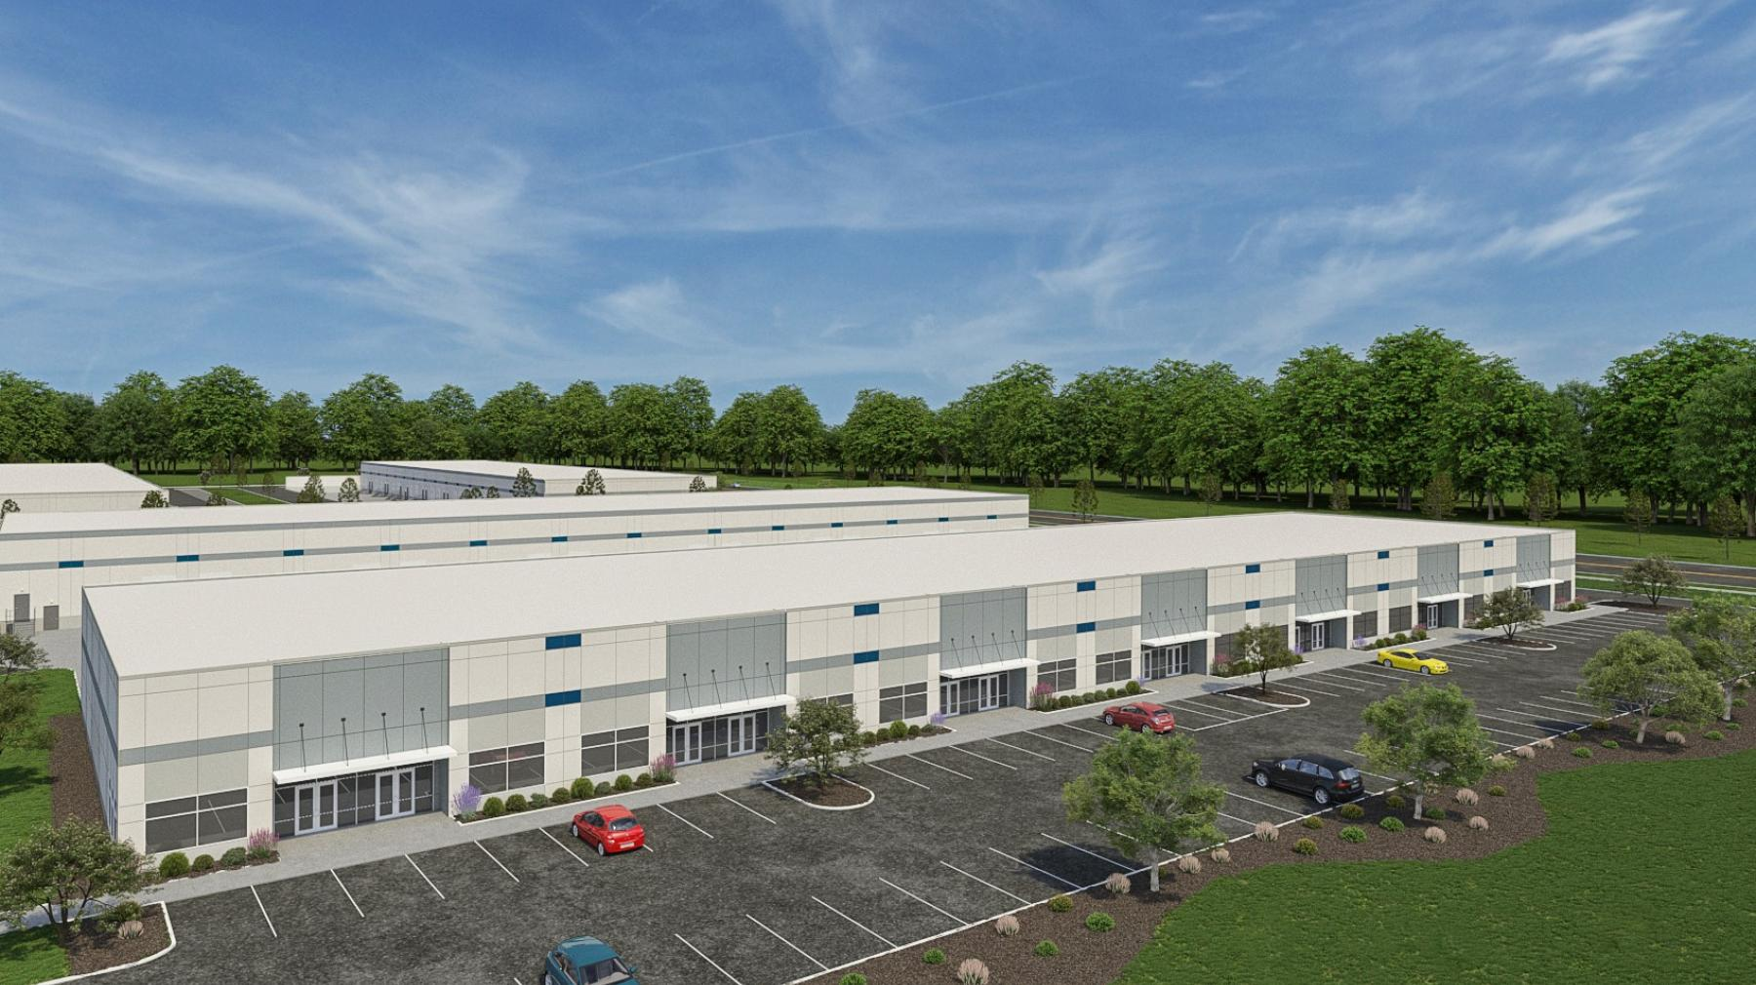
Geobudgeting: Commercial
Where will new jobs go?
Current projections show 20,000 more people moving to the area over the next 20 years. With this in mind, Lacey must find space for approximately 9,000 new jobs.
Mixed Use
(homes over businesses)
Commercial
Larger
Commercial Center
Light
Industrial

Slide 21
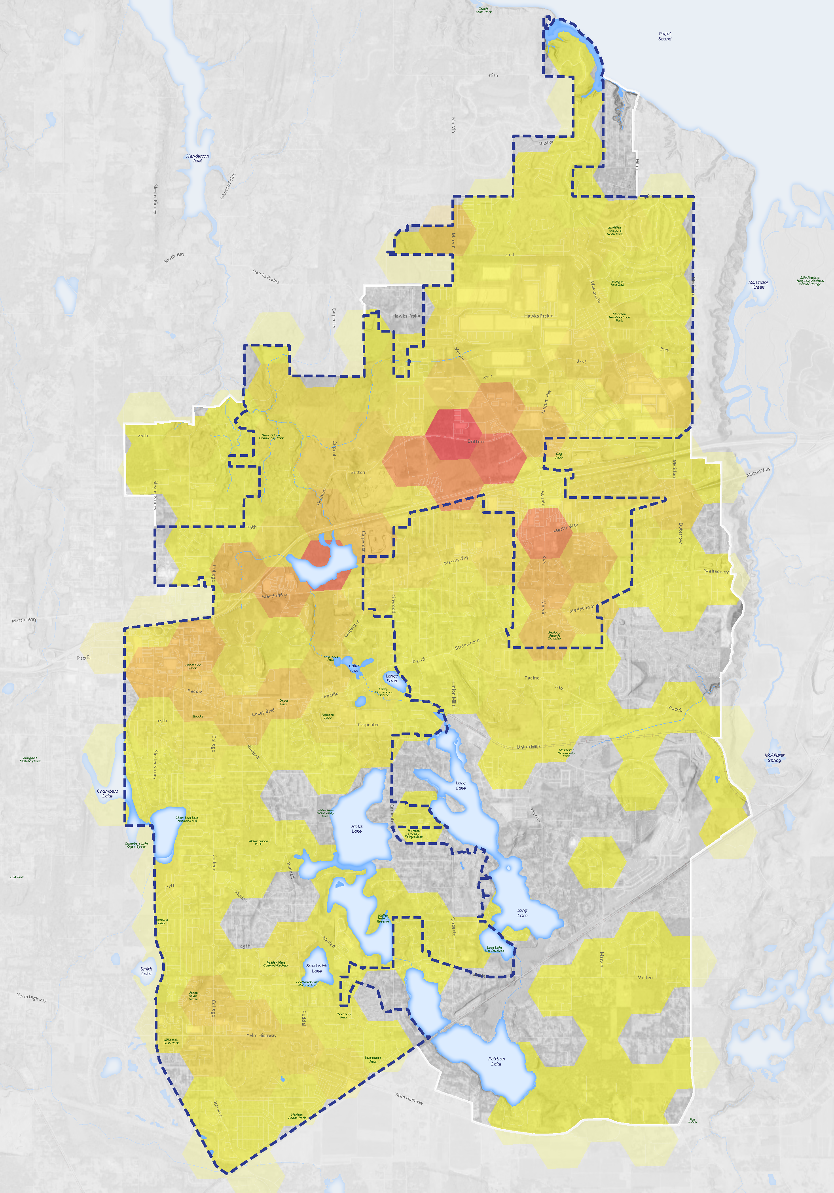
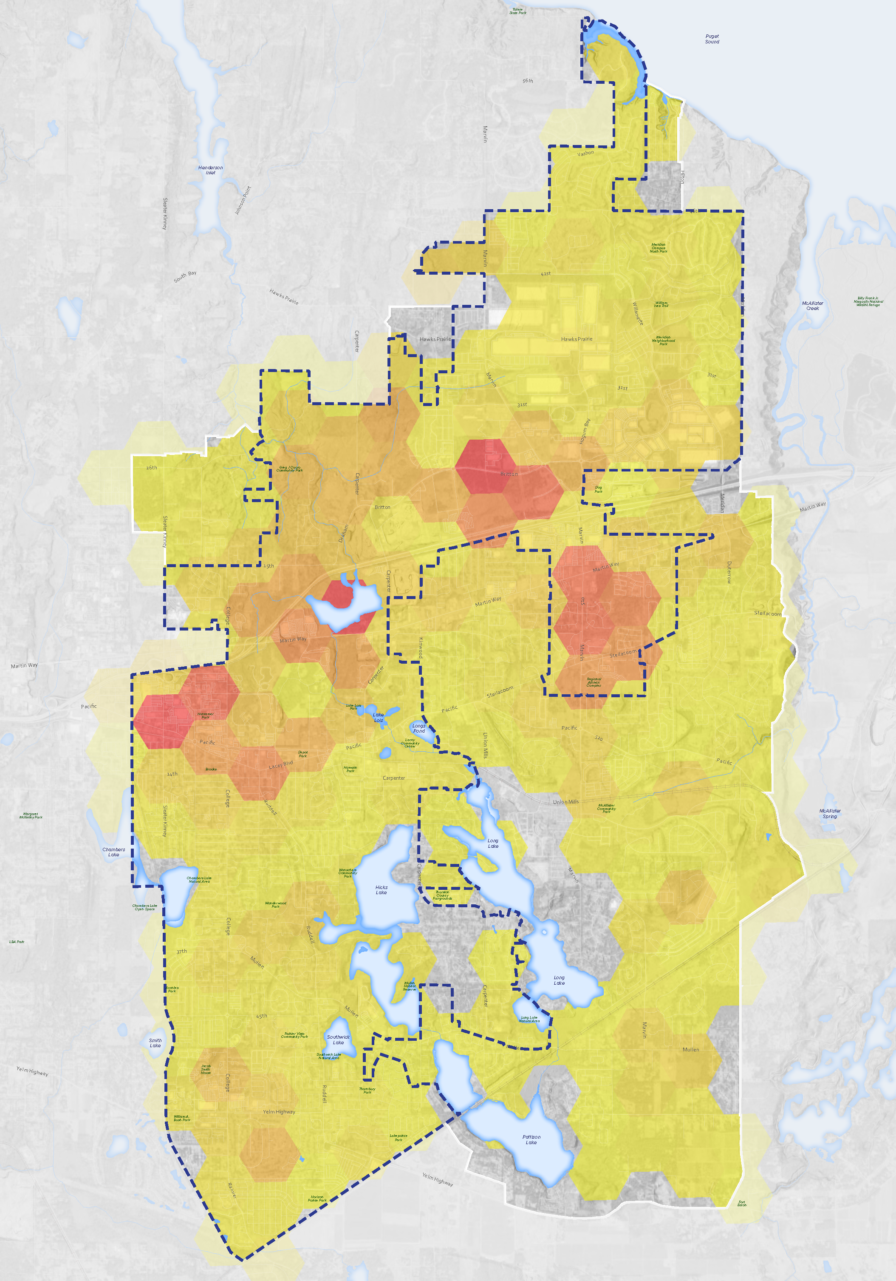
Commercial
Residential
41st & Marvin NCD
NTSD Future Site
Cabela’s &
Quiemuth Village
Woodland Creek Wetlands
RAC &
Nisqually MS
Geobudgeting: Combined
South
Sound Center
College St
Yelm Hwy

Slide 22
Future Land Use Map Alternatives
Updated Approach
Future Land Use Map to be adopted into 2025 Comprehensive Plan
Changes to Future Land Use Map require Legislative Review
Reduces review time of rezone requests consistent with Future Land Use Map
Future Land Use Map
Identifies the general location and intensity of land uses
Implements goals and vision of the Comprehensive Plan (20yrs)
Zoning Map
Identifies the currently permitted uses of a specific property
Title 16 of Lacey Municipal Code
Implements the Future Land Use Map
Vs.

Slide 23
Next Steps

Slide 24
Community Open House
Wednesday, February 12th, 2025
Location: City Hall Council Chambers
Time: 6:00 p.m. – 8:00 p.m.
Format: Open House/Drop In
Materials will also be made available through Project Website
Event Topics
2024 Community Survey Results
Comprehensive Plan Elements
Future Land Use Map Alternatives
Phase 3: Drafting the Plan and How to Participate

Slide 25
Community Engagement Phasing
Visioning
(Summer/Fall 2024)
Community
Priorities
(Winter 2024/25)
Draft Plan
(Spring 2025)
Final Plan
(Summer 2025)
Opportunities for public engagement throughout the update process…

Slide 26
Next Steps
Develop Draft Elements
Concurrent review of each element by Planning Commission and City Council
Additional community review (late spring)
Final drafting (summer)
City Council Adoption (by December 31, 2025)

Slide 27
Questions

