Slide 1
Lacey Climate Element
December 11, 2024

Slide 2
HB 1181: Climate Change Planning
Purpose:
Improve the State’s response to climate change by updating the State’s planning framework.
Goals:
Reduce sprawl
Encourage multi-modal transportation systems
Reduce Vehicle Miles Traveled (VMT)
Reduce greenhouse gas (GHG) emissions
Retain open space and enhance those spaces
Plan for climate resiliency

Slide 3
Climate Element
Per the mandate from HB-1181, the city will create a new climate element that contains two sub-elements:
GHG Emissions Reduction Sub-element (Mitigation)
Climate Resiliency Sub-Element (Adaptation)

Slide 4
Climate Element

Slide 5
Thurston Climate Mitigation Plan
In 2009, Lacey completed the Carbon Reduction and Resiliency Plan (CR2), which identified climate risks to the city and outlined actions to mitigate those impacts through preparedness and greenhouse gas reductions. The Lacey City Council adopted the CR2 plan as an appendix to the Lacey Comprehensive Plan in 2016.
In 2013, TRPC adopted Sustainable Thurston, which set a priority goal for the Thurston region to “move toward carbon neutrality,” and identified “find resources to work on climate change” as a first action step.

Slide 6
GHG Sub-element Requirements
Requirement 1: Result in reductions in overall greenhouse gas emissions generated by transportation and land use within the jurisdiction but without increasing emissions elsewhere in Washington:
Requirement 2: Result in reductions in per capita vehicle miles traveled within the jurisdiction but without increasing greenhouse gas emissions elsewhere in Washington; and,
Requirement 3: Prioritize reductions that benefit overburdened communities in order to maximize the co-benefits of reduced air pollution and environmental justice.

Slide 7
Interdepartmental Climate Team
This team is comprised of various city departments and will work on editing, creating, and approving goals/policies for adoption to the comprehensive plan.
Public Works
City Managers Office
CED
Parks and Recreation
Facilities
Emergency Management

Slide 8
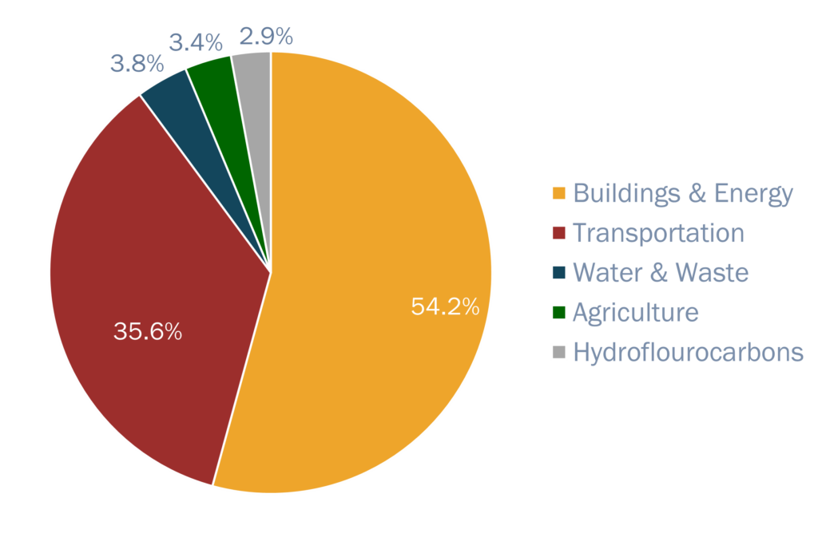
2022 Thurston County GHG Inventory

Slide 9
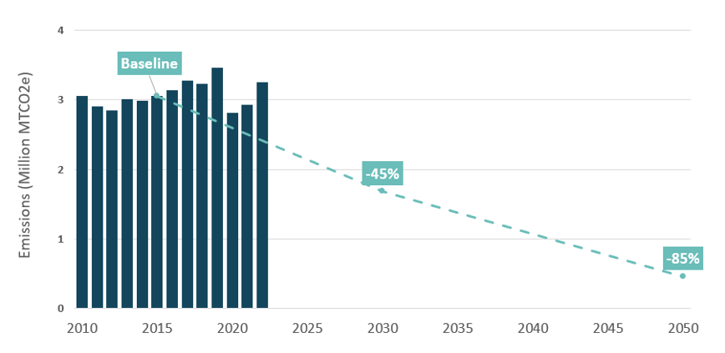
TCMP Goals
Notes:
Will need to update these goals for the comp plan-net zero by 2050.

Slide 10
GHG Emissions Reduction Goals
Greenhouse gas emission limits
In 2020, the Washington Legislature set new greenhouse gas emission limits in order to combat climate change. Under the law, the state is required to reduce emissions levels:
2020 – reduce to 1990 levels
​2030 – 45% below 1990 levels
2040 – 70% below 1990 levels
2050 – 95% below 1990 levels and achieve net zero emissions
Notes:
Re-align TCMP goals with the state’s goals: and utilize TCMP actions to meet those goals. (Menu of measures)

Slide 11
GHG Sub-element Steps to Adoption
Step 2: Set Emissions-Reduction Targets
Update TCMP goals to align with the state’s mandated goals.
Step 3: Develop Measures and Implementation Plan to Achieve Targets
Utilize TCMP and the actions to reach target goals.
Present the data results (inventory) and goals to the community with the opportunity for engagement and feedback.
Step 4: Integrate Measures into Plan and Evaluate Progress
Utilize our internal staff team and climate staff team to integrate these GHG reduction goals and policies into the comprehensive plan.

Slide 12
Lacey Resilience Sub-Element
December 11, 2024
Notes:
Ron
Thank you, Ryan and Linsey. Good evening commissioners.
My name is Ron Whitmore, and I’m a Principal with Raimi + Associates. Raimi + Associates is working with City staff and the Climate Team to prepare the Resilience Sub-Element.
I’ve been working in community sustainability for over 30 years across all sectors, including 13 years as a long-range planner and sustainability director in local government. For Raimi + Associates, I manage a mix of comprehensive plan updates and climate planning.

Slide 13
Consultant Team
Raimi + Associates
Ron Whitmore Principal-in-Charge
Robyn Wong Project Manager and Climate Adaptation Analysis and Policy
Meghan McNulty
Comprehensive Plan Policy Development
+ GIS and engagement support staff
Mission: Working collaboratively with our clients, R+A channels our passion and expertise to foster healthy, equitable, and resilient communities.
Services: comprehensive plans, climate plans, environmental justice policy, master plans, zoning codes, design standards, green building, health policy, engagement, social research, program evaluation
Staff: highly collaborative, nimble, 24-person staff
Notes:
Ron
Raimi + Associates is a mission-driven firm working across the western region of the US. We have a diverse portfolio of planning, research, and evaluation projects, including comprehensive plans, GHG and climate adaptation plans, environmental justice plans, urban design projects, and code updates.
We pride ourselves in being nimble and collaborative.
I have the pleasure of working with Robyn Wong and Meghan McNulty on the Lacey Resilience Sub-Element. Robyn is one of climate adaptation and resilience team leads and also works on many GHG reduction plans. Meghan is based in the NorthWest and is one of our comprehensive plan policy leads.
I’m not going to turn it over to Robyn, who will provide an overview of our work with the City and of some of the work completed, in progress, and that is coming soon.

Slide 14
Resilience Sub-Element Overview

Slide 15
Resilience Sub-Element Purpose
Purpose:
Equitably enhance resiliency to avoid or reduce the adverse impacts of climate change in human communities and ecological systems through goals, policies, and programs consistent with credible science
Objectives:
Address natural hazards created or aggravated by climate change
Identify, protect, and enhance natural areas
Consider social, economic, and built environment factors to support adaptation consistent with environmental justice
Prioritize actions that benefit overburdened communities
Notes:
Robyn
While the Climate Sub-Element that Linsey discussed previously has to do with reducing Lacey’s contribution to climate change, the Resilience Sub-Element recognizes that the impacts of climate change are already occurring and are projected to get worse over time. This Sub-Element aims to reduce the negative impacts to people (particularly those who have high social vulnerability), and built and natural assets.

Slide 16
Project Scope
Technical Analysis: Assess existing plans and policies; assess climate vulnerabilities
Develop Policies: Develop a framework of adaptation and resilience policies
Comprehensive Plan Amendments: Prepare the Resilience Sub-Element (including multiple drafts and public review)
Code Audit: Identify City code that will need to be amended to align with the Comprehensive Plan Amendment
Engagement throughout in partnership with the City and MIG
Notes:
Robyn
Why we need to do these things

Slide 17
Workplan
 | 2024 |  |  |  | 2025
Task | Sept | Oct | Nov | Dec | Jan | Feb | Mar | Apr | May | Jun
Project Kickoff & Data Assembly
Resilience Sub-Element Factsheet
Comp Plan Online Survey
Listening Sessions
Plan + Policy Audit
Vulnerability and Risk Assessment
Policy Framework
Comp Plan Public Workshop
Public Draft Comp Plan Amendments
Code Audit
Blue: Technical Work
Orange: Community Engagement
Resilience Sub-Element adoption will proceed with the other Comp Plan updates in December 2025
Notes:
Robyn

Slide 18
Work Completed to Date
Notes:
Robyn

Slide 19
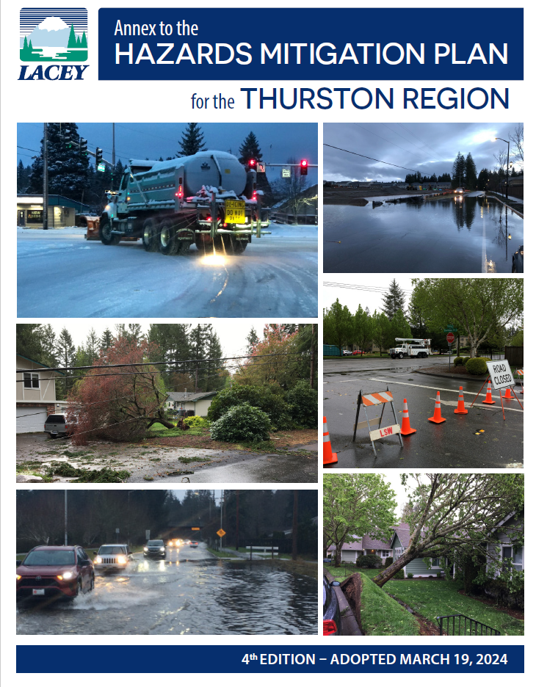
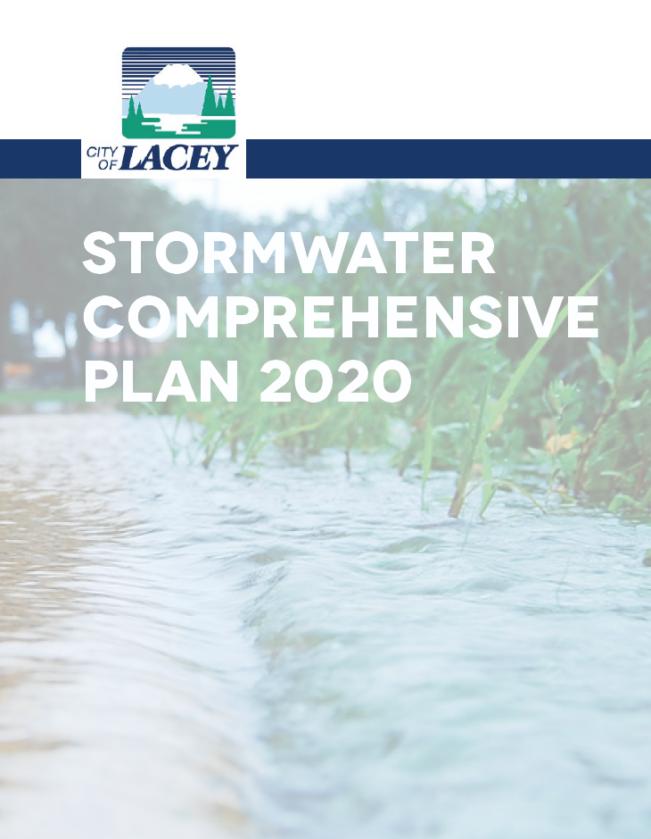
Plan and Policy Audit
Review of climate goals and policies in existing City plans to understand gaps and opportunities to incorporate climate resilience
Key findings
Incorporate policies from the Lacey Annex to the Thurston County Hazard Mitigation Plan
Consolidate detailed policies in existing departmental plans into higher-level resilience policies
Add measures to address heat and wildfire impacts
Prioritize measures to increase the resilience of vulnerable communities
Notes:
Robyn
(Why is this meaningful) We do two foundational sets of analysis …. Understand the existing policy (summary is included in your packet) and the other is deeper analysis of climate vulnerability and risk
(What do we use the outputs for)
Review of eight plans, including all elements of 2016 comp plan, county hazard mitigation plan and annex, other plans related to city infrastructure and facilities.

Slide 20
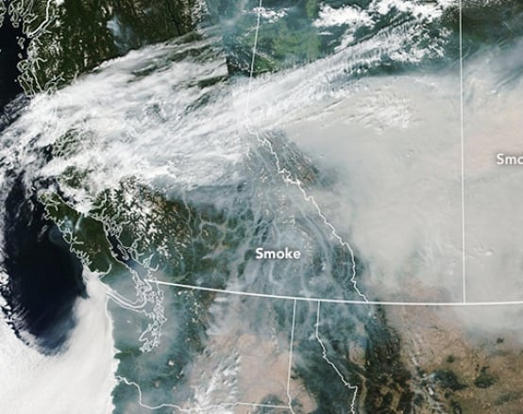
Vulnerability and Risk Assessment (in progress)
Mapping and data indicate Lacey faces relatively little direct exposure to climate hazards like flooding, sea level rise, wildfire, and extreme heat
Other impacts:
Observed increase in damaging wet microburst storms with extreme winds
Wildfire smoke from wildfires outside of the city
Smoke from B.C. wildfires in 2018
Notes:
Robyn
____
(Thurston County HMP was done recently and Lacey Hazard Mitigation Plan Annex was completed very recently (April 2024)
Compared to other cities in Thurston County, Lacey has relatively little exposure. However there are hazards which don’t have as much of a mappable impact, like storms and smoke. )

Slide 21
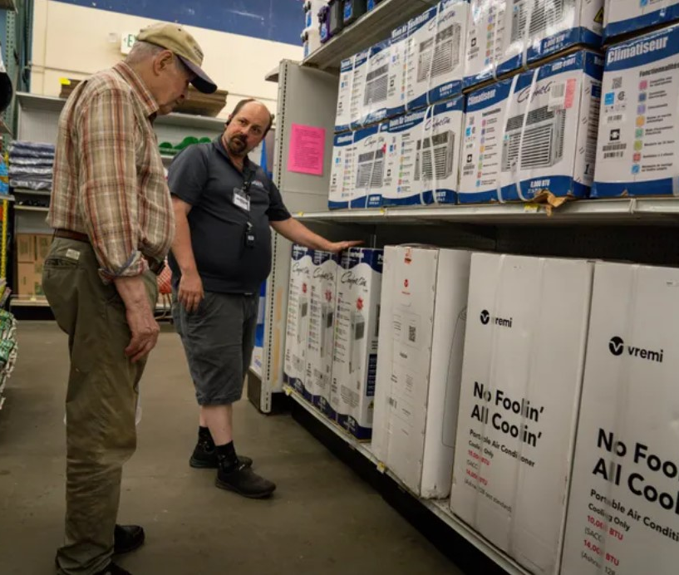
Vulnerability and Risk Assessment
Vulnerability and risk to hazards is increased by population and building characteristics, such as:
Age (older adults and children), income, language access
Buildings without air conditioning
Mobile/manufactured homes
Notes:
Robyn
_____

Slide 22
Listening Sessions
We heard from:
Realtors
Climate advocates
Organizations representing vulnerable populations (pending)
Key findings:
Increase resilience to heat and wildfire smoke
Power outages will exacerbate risks during climate hazard events
Improve communication about climate change, especially anticipated heat and health impacts
Notes:
Robyn
__Supplementing our technical knowledge….. These sessions are an important source of local knowledge and help us understand and how people are experiencing the impacts of climate change in their lives and work. While we had these sessions early on to set the stage, we anticipate having an ongoing dialogue with community members with different perspectives throughout the project.
Real Estate Interests
Thurston County Realtors Association
Climate Advocates
Thurston Climate Action Team
Evergreen State College Center for Climate Action and Sustainability
Vulnerable Populations
_______
_______
Other people who we have reached out to include:

Slide 23
Planning Commission and City Council Input
Notes:
Ron
Thank you, Robyn. The Planning Commission and City Council are important partners in this effort, so we wanted to give you a preview of what’s to come.

Slide 24
Planning Commission and Council Input
 | 2024 |  |  |  | 2025
Task | Sept | Oct | Nov | Dec | Jan | Feb | Mar | Apr | May | Jun
Project Kickoff & Data Assembly
Resilience Sub-Element Factsheet
Comp Plan Online Survey
Listening Sessions
Plan + Policy Audit
Vulnerability and Risk Assessment
Policy Framework
Comp Plan Public Workshop
Public Draft Comp Plan Amendments
Code Audit
Comp Plan PC/Council Joint Session: February 2025
Resilience Sub-Element Policy Frameworks: March 2025
Resilience Sub-Element Public Draft Comp Plan Amendments: May – June 2025
Comp Plan Update Adoption: December 2025
Blue: Technical Work
Orange: Engagement
Star: PC and Council Touch Point
Notes:
Ron
As Robyn noted, we’ll soon transition from analysis to policy writing. Specifically, we look forward to discussing the draft Policy Framework with you in February and March. The Policy Framework will identify the goals and policies that will serve as the foundation for the Resilience Sub-Element.
Later in the spring, we’ll seek your input on the draft Sub-Element.
Thank you for the opportunity to introduce our work on the Resilience Sub-Element.
I’ll now turn it back over to Linsey and Ryan.

Slide 25
